Slide 1
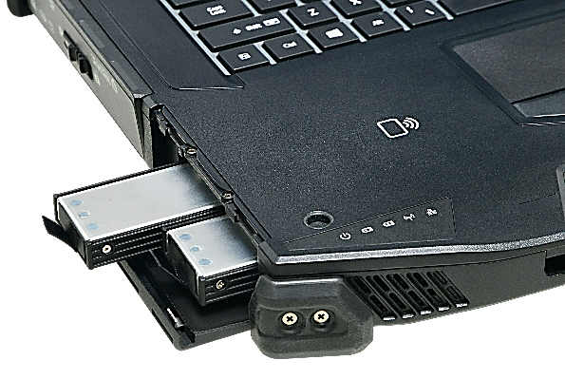
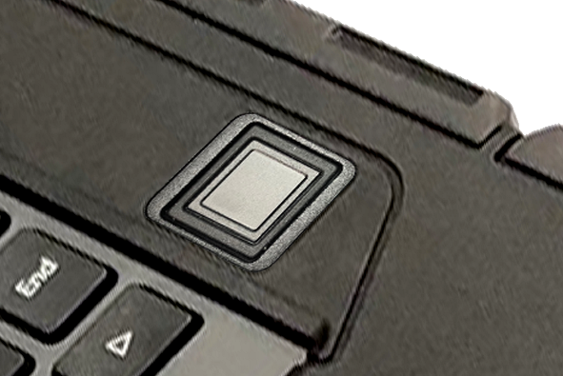
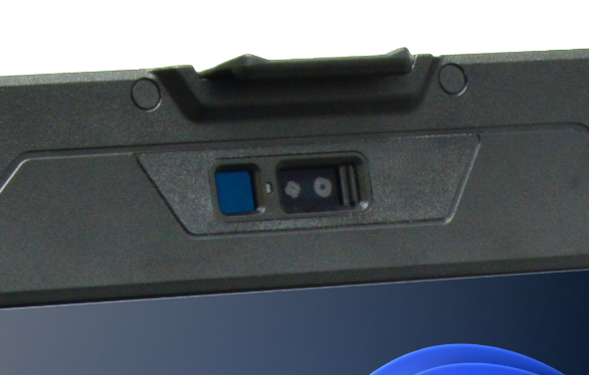
DURABOOK Z14I INTRODUCTION
DURABOOK MARKETING DIVISION

Slide 2
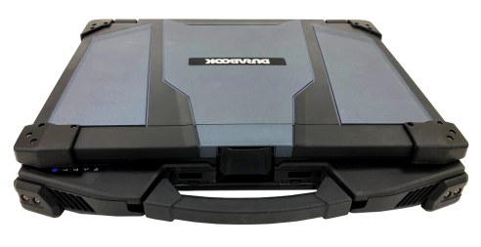
UNIQUE SELLING PROPOSITION
Extraordinary Computing Performance
Robust and Secure Inside Out
Endless Configuration Possibilities
Best For Outdoor Use
Intel® Meteor Lake Core™ Ultra U Processors
Embedded AI Boost NPU
Intel Iris Xe-LPG Graphics
Optional NVIDIA GPU/ AI Accelerator
IP66, 6’ Drop
MIL-STD 810H & 461G
Wide Range Temp (-29°C - 63°C)
Dual Quick-Release Storage
Windows 11 Secured-Core PC
Windows Hello Camera
Coolfinity™ Fanless Design
14” Full HD DynaVue Technology up to 1200 nits
Night Vision / Stealth Mode
Four Touch Modes
Long Lasting Battery with Battery charging protection
Abundant I/O Ports with
two Thunderbolt 4, three USB Type A, two RJ-45, two RS-232
Wi-Fi 7, BT5.4, 4G/5G, Dual SIM
Expansions of PCIe Interfaces, discrete VGA, RAID box and military-grade connectors

Slide 3
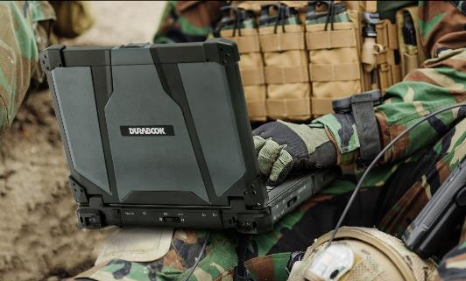



TARGETS & APPLICATIONS
Applications
Military/Government
Public Safety
Emergency Management / Field Operation Command
Mapping/Dispatching
Edge Computing
Surveillance Solution
CAD Applications
Assets Management
Maintenance Diagnostic Tool
On-Site Project Management
Industrial/Manufacturing
Professional Service

Slide 4


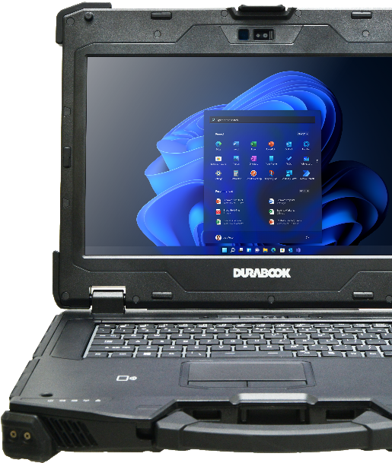

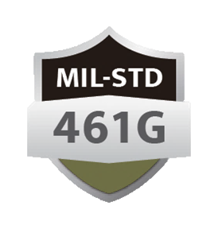





Z14I FEATURES HIGHLIGHT
The Most versatile FULLY-RUGGED LAPTOP
Intel® Core™ Ultra 5 125U up to 4.3 GHz/ Ultra 7 155U up to 4.8 GHz; with vPro Technology.
Embedded Intel® AI Boost NPU
14” FHD (1920 x1080) with 1,200 nits DynaVue® sunlight readable display and capacitive multi-touch function
Dual removable quick-release storage drives
COOLFINITY™ fanless design with hot-swappable batteries
Windows 11 Secured-Core PC ready
Optional NVIDIA® RTX A500 Graphics / AI Accelerator
MIL-STD-810H, 6ft drop & IP66 certified, optional ANSI/UL C1D2

Slide 5


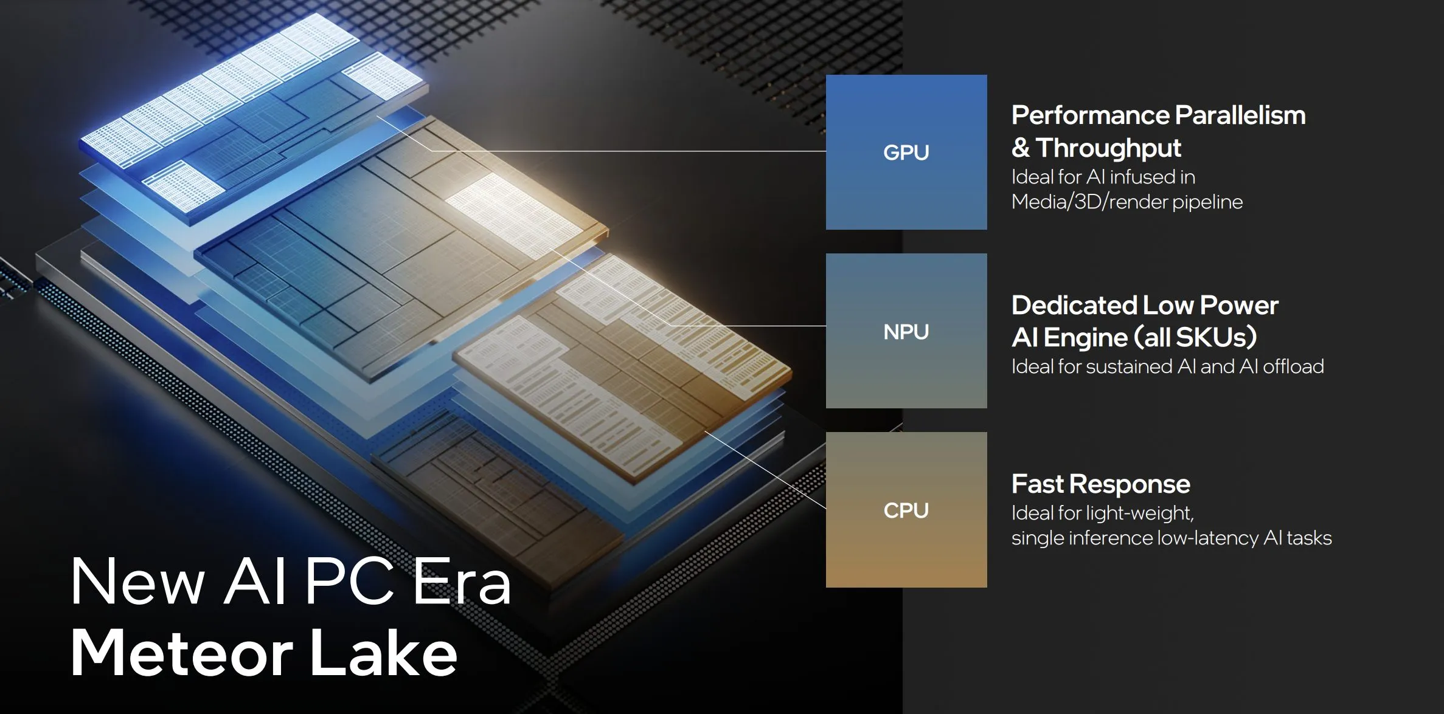
7nm
COMPUTING POWER WITH AI
14th generation CPU
Z14’s Meteor Lake Core™ Ultra Processor, with 3 types of performance-tailored cores totaling to 12 cores, boasts a 12MB cache, achieving 37% higher performance than previous generation. Intel® Meteor Lake processor also offers true Hardware AI Acceleration with multi-compute engines, CPU + GPU + AI Boost NPU.
Manufactured with Intel 4 (7nm) semiconductor process, Core Ultra CPU offers 20% higher performance per watt than 11th Gen Tiger Lake 10nm CPU.
 | Intel® Core i5 1135G7 | Intel® Ultra 5 125U Meteor Lake | Intel® Ultra 7 155U Meteor Lake
Turbo Speed | Up to 4.2 GHz | Up to 4.3 GHz | Up to 4.8 GHz
# of Physical Cores | 4 Cores | 12 Cores | 12 Cores
Cache | 8MB | 12MB | 12MB
CPU Mark | 9,834 | 13,561 | 14,973

Slide 6
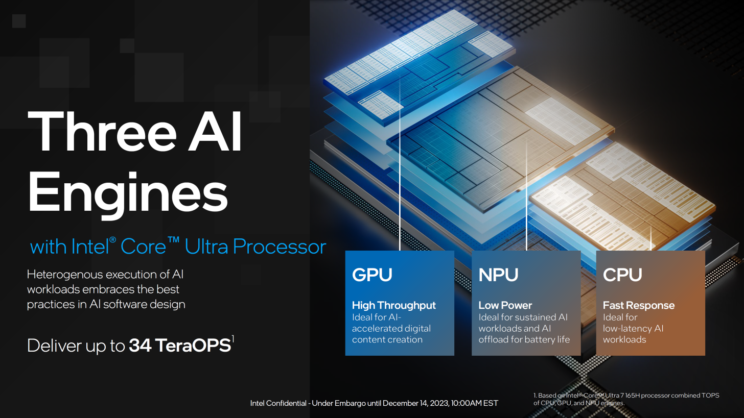
NEW PC LEVEL - INCREDIBLE AI
Z14I with an Intel® Core™ Ultra processor, is Durabook’s first AI Ready PC with three distinct AI engines:
a NPU (Neural Processing Unit) optimized for AI operations, a GPU, and a CPU.
AI intensive computations are offload to dedicated NPU processor, freeing up CPU and GPU’s computing power to enhanced total platform performance.
Combined AI engines of CPU, NPU and GPU offering unprecedented AI computing power opens unlimited possibilities.

Slide 7
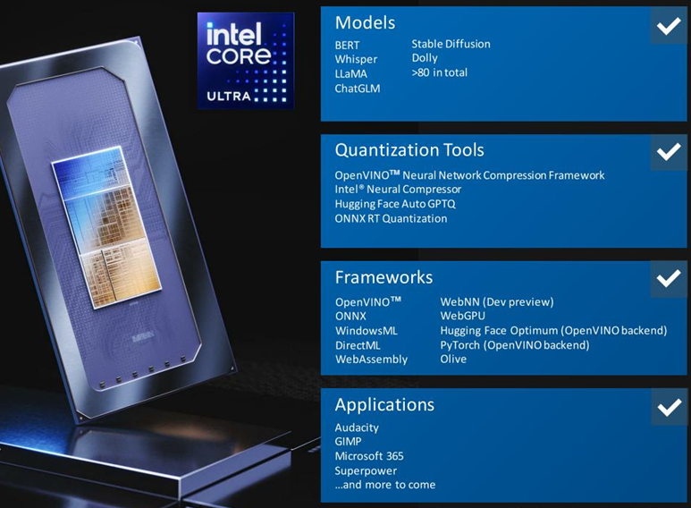
AI PC RIGHT AT YOUR FRONT
Intel® Core™ Ultra Processors run the latest LLMs, transformers and text-to-image workloads, helping you be more productive and creative.
Users may fully exploit AI on their PCs with Intel's support for hundreds of programs that already make use of it, making it the most expansive ISV ecosystem in the PC CPU market.

Slide 8
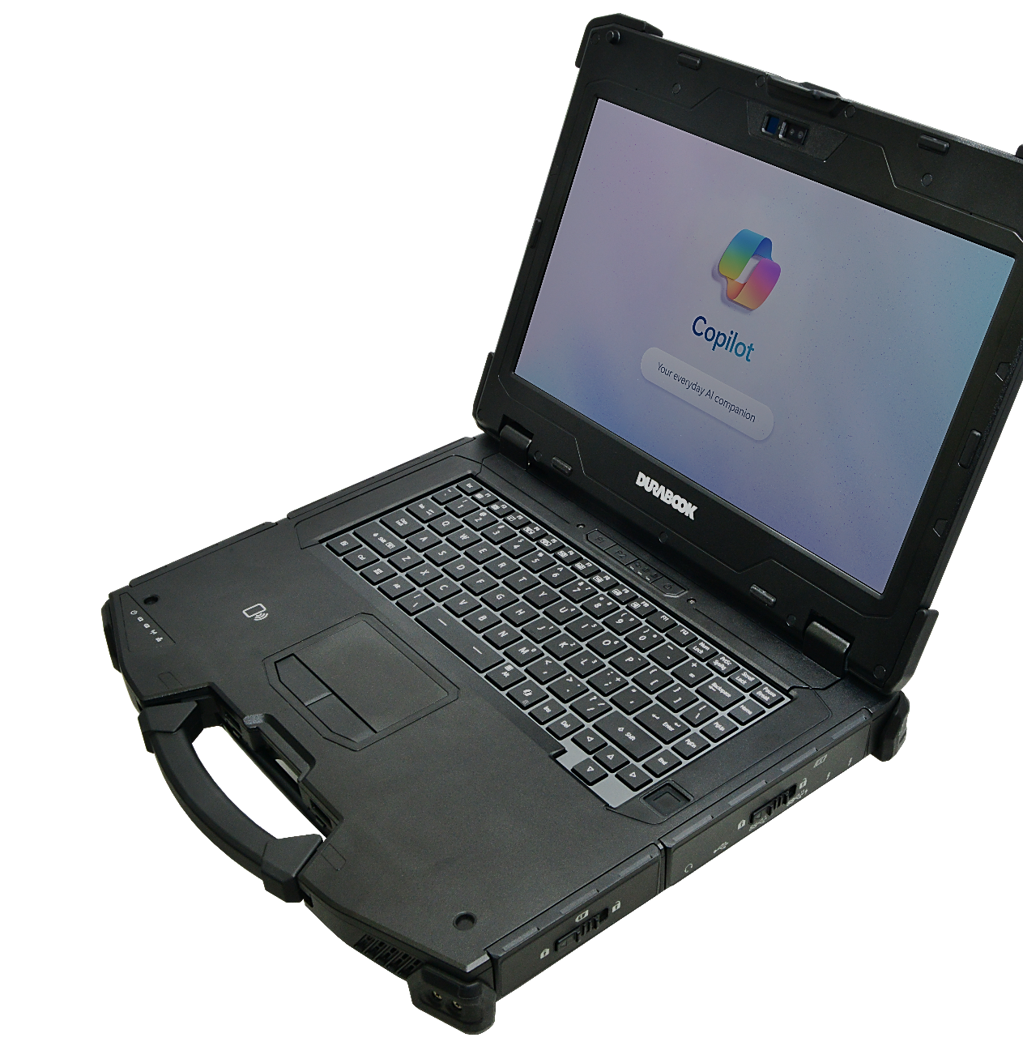
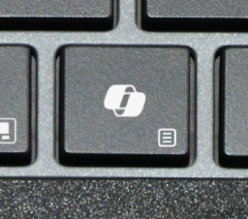

COPILOT - THE AI ASSISTANT AT WORK
Your everyday AI companion
Microsoft Copilot is an AI-powered assistant available in Windows 11.
It leverages the power of AI to boost productivity and unlock creativity.
Find answers and inspiration from the web.
Works within Microsoft 365 apps, documents, and conversations.
Integrates with security systems, data analysis, and business applications.
COPILOT KEY

Slide 9
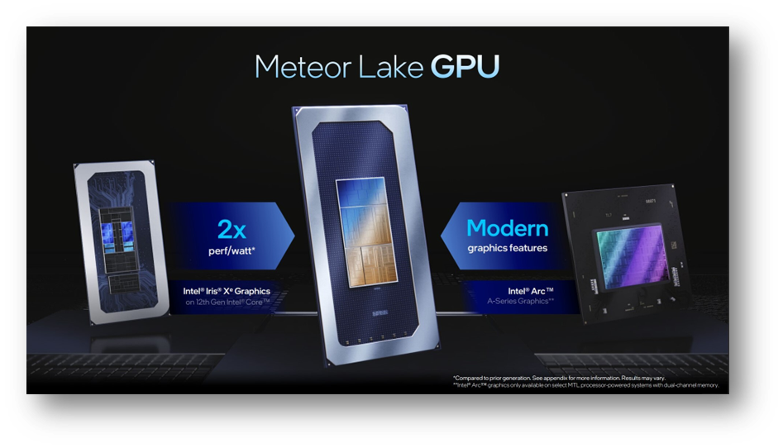


GRAPHICS PERFORMANCE
Intel® Iris Xe-LGA Graphics + NVIDIA RTX A500
The Z14I comes with enhanced Intel® Xe-LPG Graphics with 4 Xe cores, delivering a 200% higher performance/watt result comparing to IRIS Xe graphics. Its 3D rendering performance is also 2.5x faster than UHD 620.
For professionals who run massive graphic computing, the Z14I can also be built with optional discrete NVIDIA RTX A500, 6.5x tremendously faster 3D effective speed than UHD 620, delivering 100 TOPS in AI acceleration.
Source: PassMark

Slide 10

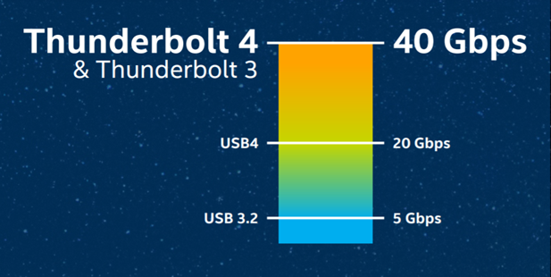
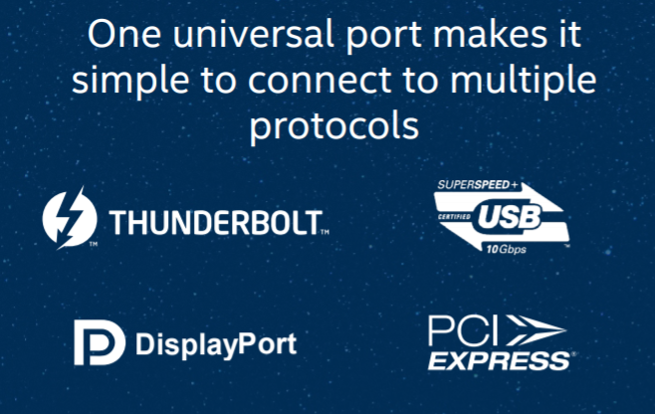
THUNDERBOLT™ 4 Technology
UNIVERSAL CABLE CONNECTIVITY
Thunderbolt 4 is the latest version of Intel's Thunderbolt line.
Thunderbolt 4 is more powerful and makes connecting the modern workspace more flexible and simpler than ever.
Delivers 40Gb/s of bandwidth
One port supports multiple protocols
  USB 4
  DisplayPort
  PCIe
Support up to 2x 4K displays
It is backwards compatible with Thunderbolt 3 & USB-C
Maximum flexibility for docking station
Bi-directional power
  Power share + power delivery (PD)

Slide 11
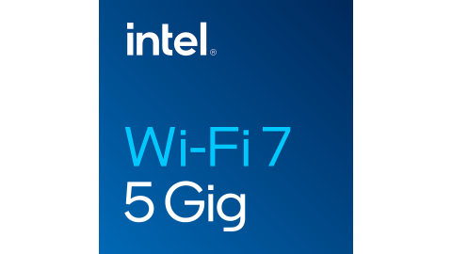

MAXIMUM CONNECTIVITY
INTEL® WI-FI 7 BE200
Intel® Wi-Fi 7 BE200, a revolution in Wi-Fi technology, provides advancement in connection speed, channel bandwidth, throughput and MLO (Multi-Link Operation).
Wi-Fi 7 provides Extremely High Throughput (EHT) and additional 320 MHz Channels.
Wi-Fi 7 BE200 has max. data transfer speed of 46 Gbps, 4.8x faster than Wi-Fi 6 AX201’s max speed of 9.6 Gbps
Wi-Fi 7 BE200 with Bluetooth® V5.4 provides data transfer range of up to 300 meters (= 984 ft)
Brand | Wireless Lan | Bluetooth | Wi-Fi Speed | Max Channel Bandwidth | Band
Durabook Z14I New | BE200 | V5.4 | 46 Gbps | 320 MHz | 2.4 GHz + 5 GHz +6 GHz (Multi Link)
Market Solution P | AX201 | V5.2 | 9.6 Gbps | 160 MHz | 2.4 GHz or 5 GHz (Single Link)

Slide 12
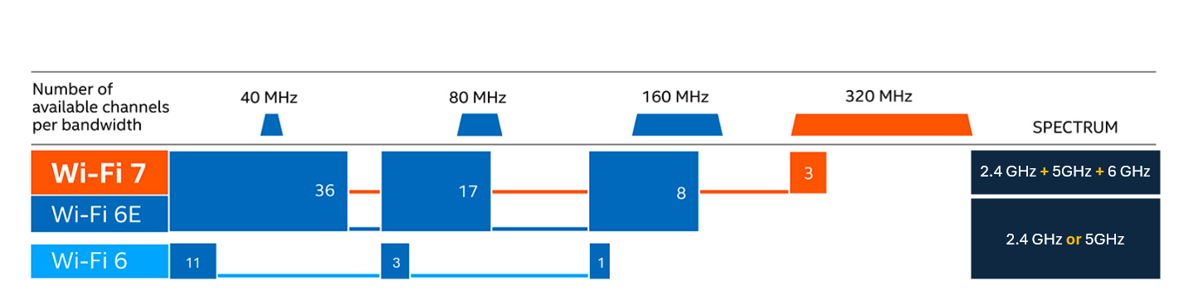
WI-FI 7 NEXT GENETATION CONNECTIVITY
Wi-Fi 7 offers a 6 GHz frequency band in addition to Wi-Fi 6’s 5 GHz and 2.4 GHz. Wi-Fi 7 also uses a unique new MLO (Multi-Link Operation) technology to transmits data by simultaneously connecting to two bands. The extended 6GHz spectrum and Multi-Link Operation offer higher data transfer speed, wider bandwidth and reduced interference.

Slide 13

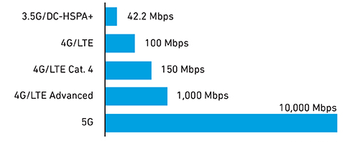
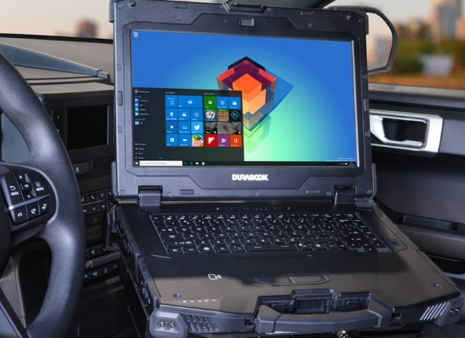


SEAMLESS CONNECTIVITY
Advanced wireless capabilities include cellular options of 4G LTE or 5G.
5G mobile connectivity offers ultrafast data transfer speed over previous generations of mobile networks, which is 100x fast than 4G LTE. Providing always-on high-speed connectivity for workers in the field with improved productivity anytime, anywhere.
Downlink Speeds by Technical Generation
GOVERNMENT SECTOR
Z14I designed with u-blox NEO M9N module to provide high GPS accuracy.
And more, featured by RF Tri-pass-through (WIFI, WWAN, GPS), in-field professionals can connect to the remote database in real time.

Slide 14

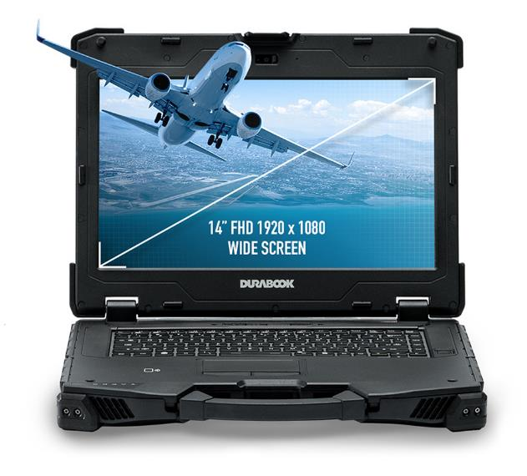

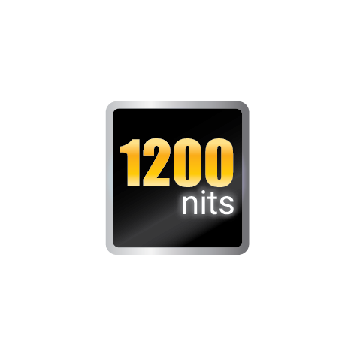
VIEW EVERY DETAIL
The New Generation of DynaVue® Technology
14” FHD (1920x1080) display.
Sunlight readable touch panel with 1200 nits DynaVue® light-filtering technology, providing a high contrast ratio (CR) to eliminate reflection and deliver the best clarity.
16:9 wide screen is the perfect ratio to view.
High Brightness
Light Filtering Technology
DynaVue®
Increased Clarity & Wider Viewing Angle

Slide 15
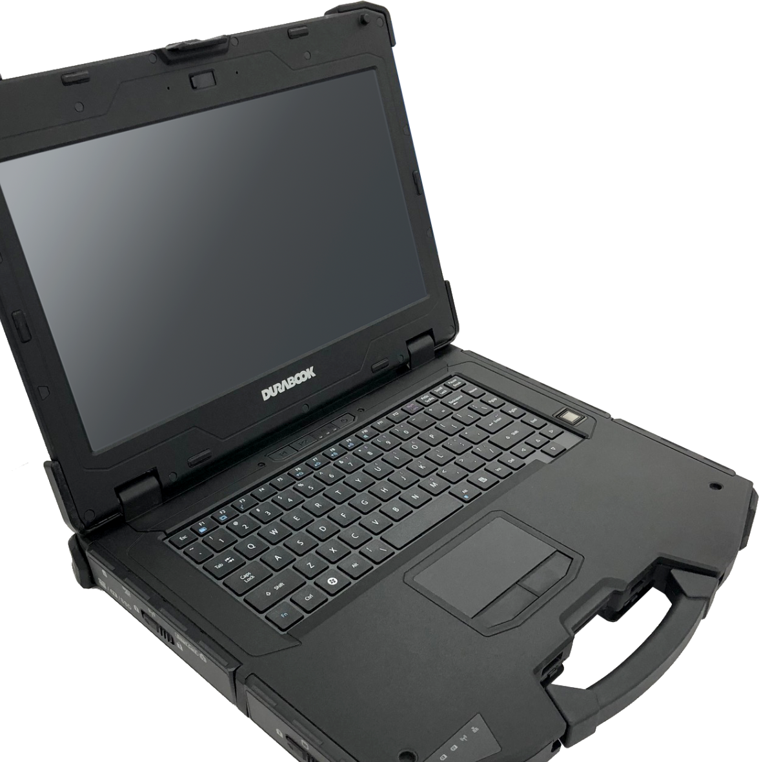





VIEW EVERY DETAIL
The New Generation of DynaVue® Technology
WHY FHD?
Image is made by lines of pixels along the vertical and horizontal axis:
  HD: 768p (1366 x 768 – approximately 1 million total pixels)
  Full HD: 1080p (1920 x 1080 – approximately 2 million total pixels)
Full HD is the standard resolution for the most HD videos now.
14” FHD
(1920x1080)
4 touch modes: glove, stylus, water and finger mode.

Slide 16
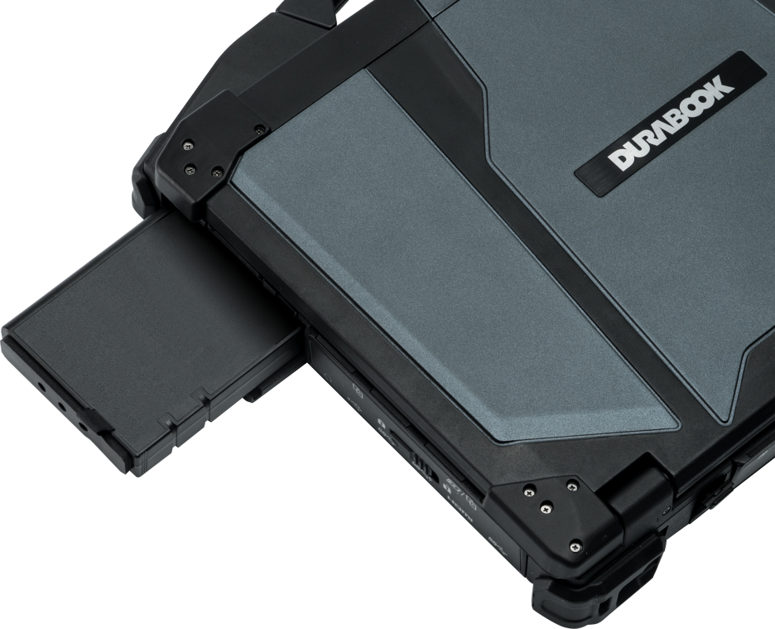

NON-STOP MOBILITY
Easy battery swappable capabilities
Zero Downtime with
Hot-Swappable Technology
What’s more, with an ultra-long battery life of 21.5 hours and
5 minutes of bridge time in between battery changes, data loss and downtime are non-issues.

Slide 17


BATTERY CHARGING PROTECTION
To reduce battery aging, Durabook has developed four battery charging modes with enhanced charging algorithms for our customers to choose from.
4 Battery modes:
Regular Mode
In this mode the battery will be fully charged.
Optimized Battery Charging (OBC)
Battery charging will stop at 80% to reduce battery aging.
Temperature Control Mode (TCM)
To extend the lifetime of the battery, charging is
enhanced based on DURABOOK intelligent algorithm
and battery temperature.
DURA² Charging (D2C)
To maximize battery performance and lifespan, charging
is enhanced based on DURABOOK intelligent algorithm
and battery temperature. Battery charging will stop at 80%.

Slide 18
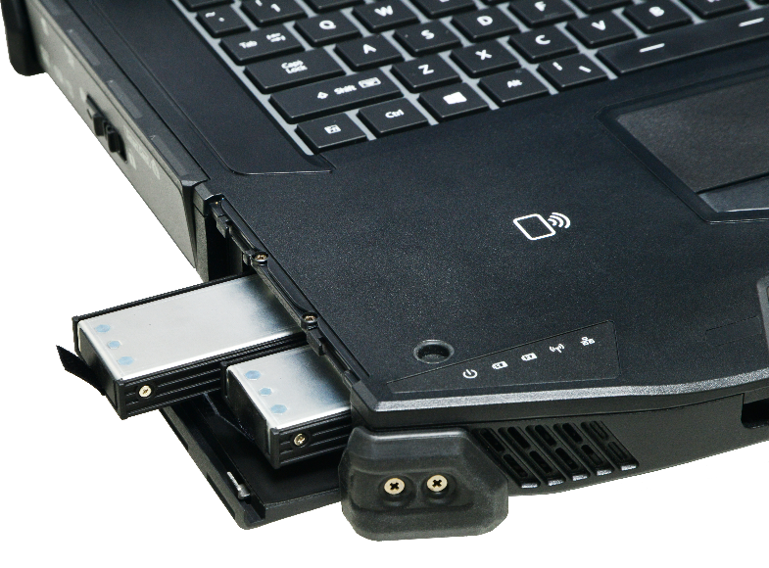
MILITARY-GRADE LEVEL SECURITY
Dual quick-release STORAGE
Dual Quick-Release NVMe PCIe SSD Storage
The Z14I features two NVMe PCIe SSDs that are quick and easy to remove. It is equipped with the latest NVMe PCIe SSD solution, providing up to 2TB of each storage.

Slide 19
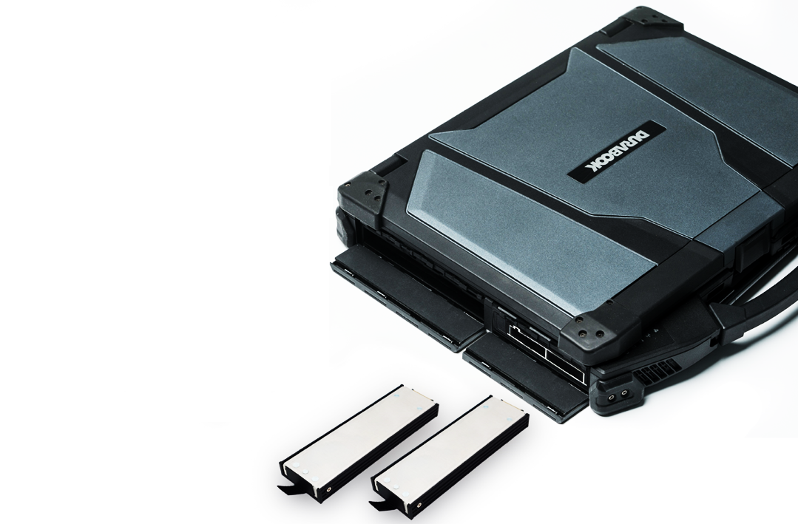
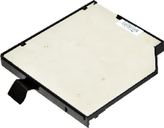
MULTI-STORAGE MANAGEMENT
Z14I is equipped with the latest NVMe PCIe SSD technology, with storage capacities ranging from 256GB to 2TB.
It can carry up to 3 SSDs, all designed with quick-release system for ease-of-use and supports RAID 0 and RAID 1.
  1 x NVMe PCIe SSD
  1 x NVMe PCIe SSD
  1 x Media Bay 2.5” SATA III SSD
Featured with NVMe PCIe SSD performance:
  Speeds up to 7000 MB/s (PCIe Gen4)
  11x faster than SATA III SSD
Type | Speed
Durabook Z14I NVMe PCIe 4x4 | 7000 MB/s
Market SATA III Solution | 600 MB/s

Slide 20
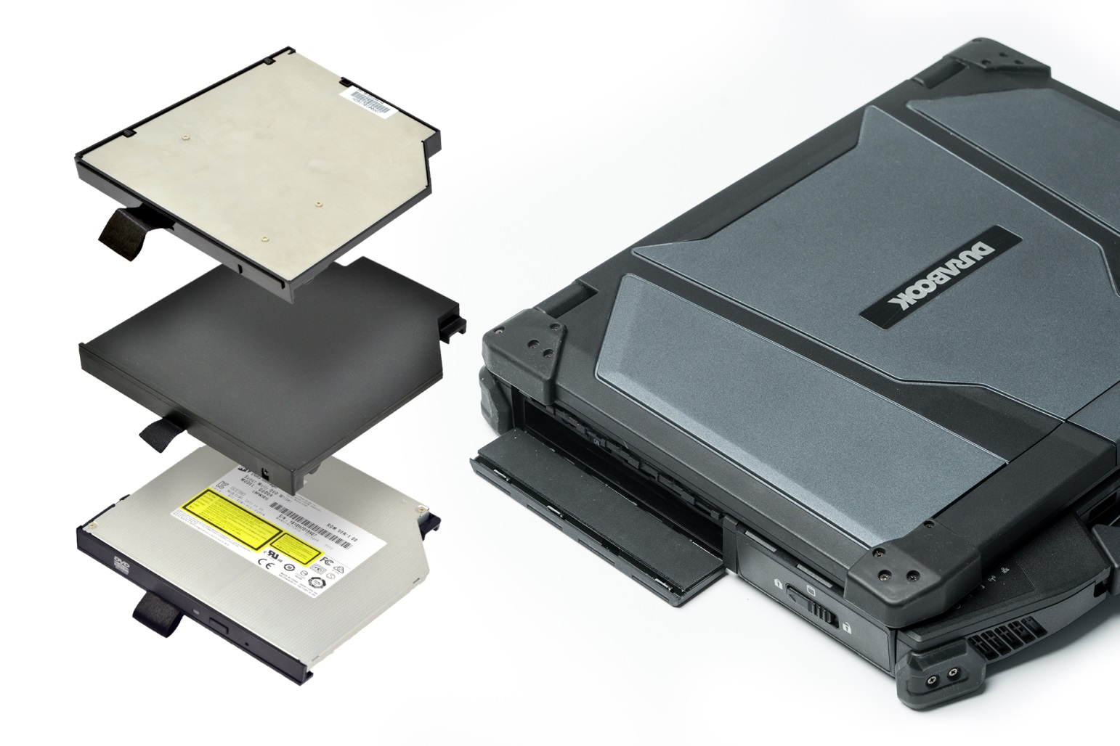
MULTIPLE WAYS OF SETUP
Media bay for your choice
Media bay options for user selection to achieve difference application fulfillments:
Optical disk drive
2nd battery
3rd storage (SATA SSD)

Slide 21

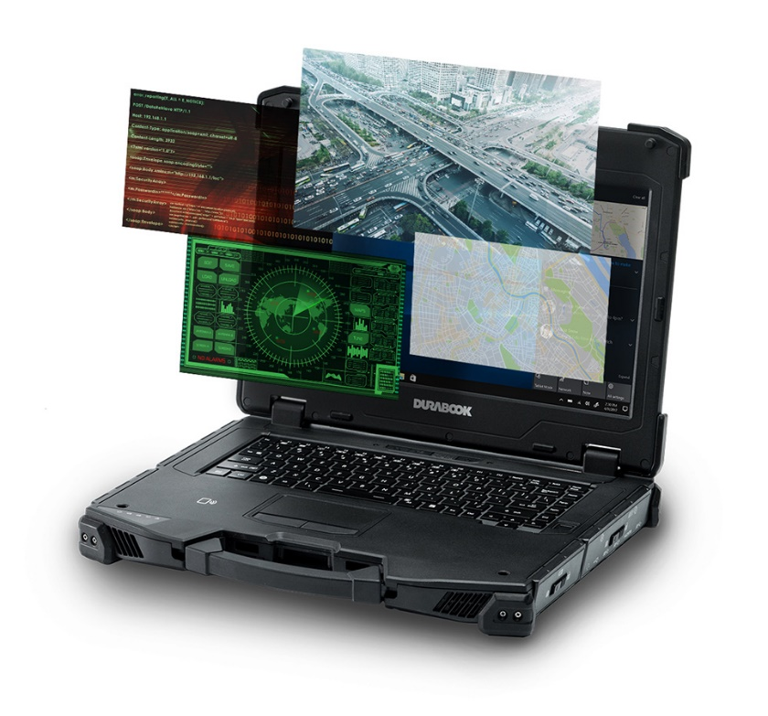
MORE RUGGED THAN EVER
MIL-STD-810H certified
With excellent design know-how, the Z14I is able to withstand harsher environmental challenges than ever.
Z14I is MIL-STD 810H certified (Drop, Shock, Vibration, Rain, Dust, Altitude, Freeze/Thaw, High/Low Temperature, Temperature Shock, Humidity, Explosive Atmosphere, Solar Radiation, Salt Fog, Fungus Resistance).
MILILTARY STANDARD CERTIFIED
Durabook Z14I | + Solar Radiation + Salt Fog + Fungus Resistance + Explosive Atmosphere
Market Solution D | N/A
Market Solution P | N/A
Market Solution G | + Explosive Atmosphere + Salt Fog

Slide 22
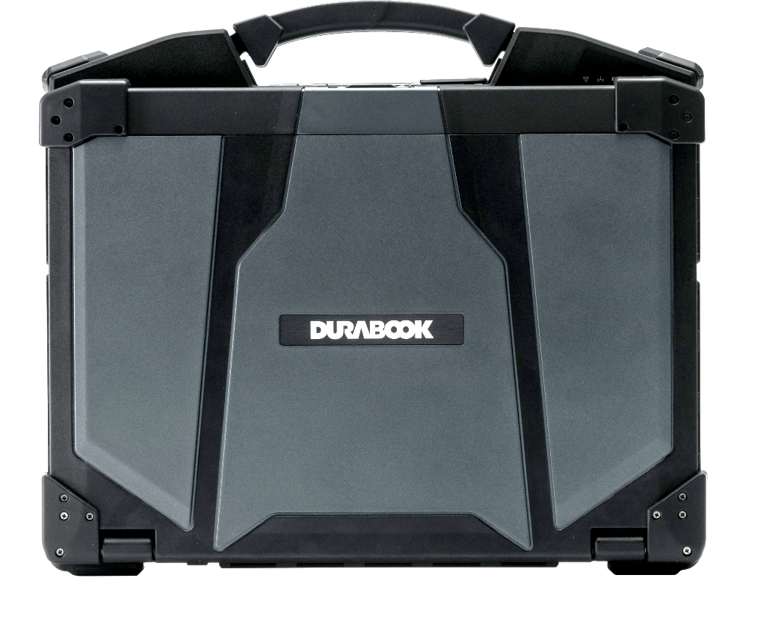


RUGGED DOMINATION
DROP RESISTANCE & IP RATING
The Z14I is born fully-rugged ready with 6-feet drop resistance and IP66 certification to withstand any harsh conditions.
MIL-STD and IP
Durabook Z14I | IP 66, 6' drop
Market Solution D | IP 65, 3' drop operating (transit 6’ drop)
Market Solution P | IP 66, 6' drop
Market Solution G | IP 66, 6' drop

Slide 23
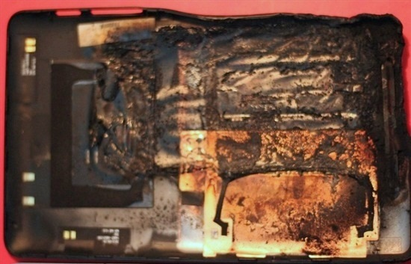

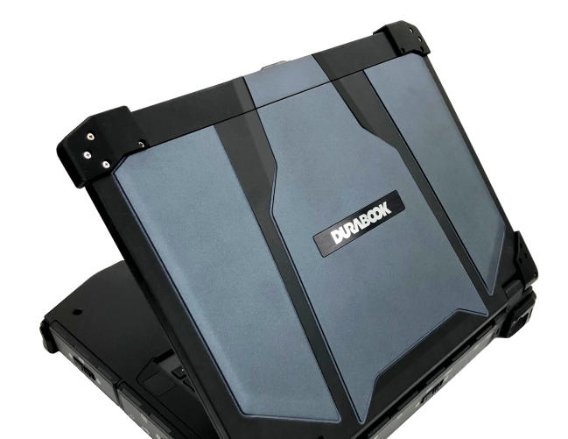
COOLFINITY™ FANLESS DESIGN
No fan, no pain – dust free, noise free
Fan failure is one of most common reasons lead to system overheat, and therefore damaging other components. Especially in desert environment, the fan failure rate is becoming higher.
COOLFINITY™ fanless design also means free-of-noise. In some user scenarios, such as battlefield, hospital and stealth mode, every peace matters.
Acoustic Test
Durabook Z14I | 0 dBA
Market Solution D | 40 dBA
Market Solution P | 43.9 dBA

Slide 24
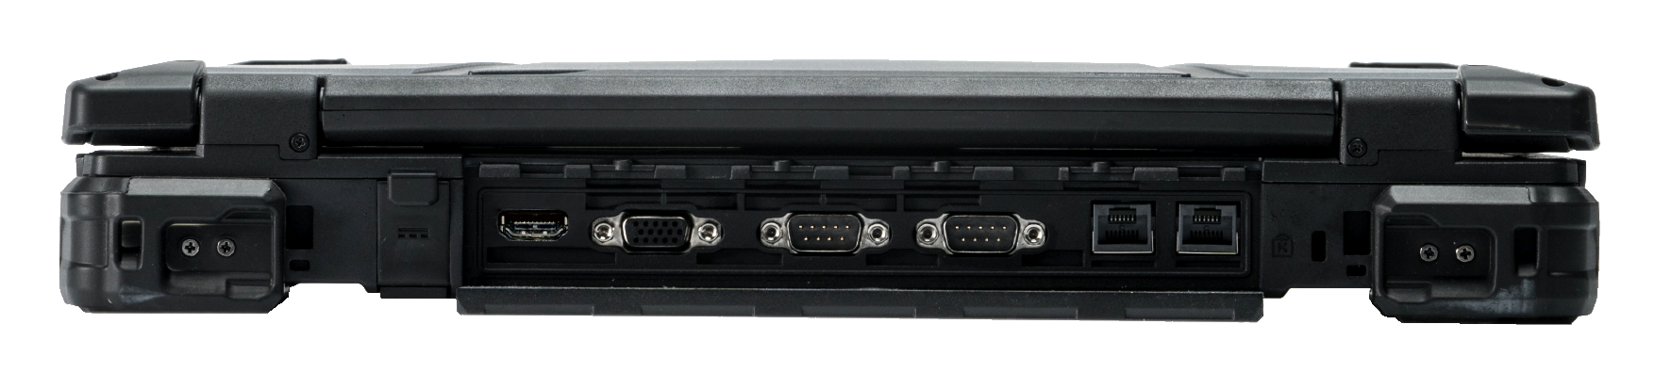







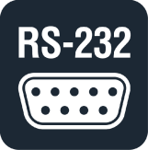
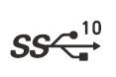
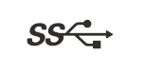

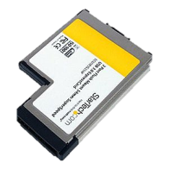

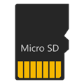

SPEAK ALL LANGUAGES
expandable and configurable I/O options
Default built-in:
Thunderbolt 4 (Type C) x 2
USB 3.2 Gen 2 (Type A) x 1,
USB 3.2 Gen 1 (Type A) x 1,
USB 2.0 (type A) x 1
HDMI 2.1 + VGA ports
RJ-45 x 2
RS-232 x 2 (support 422 and 485)
Smart Card/CAC reader
Dual SIM (Nano SIM & eSIM)
microSD card reader
ExpressCard 54
Optional RFID reader *
Optional fingerprint reader *
* by project support
HDMI
Support
Multiple
Displays
VGA
Support
Multiple
Displays
RJ-45
for Data
Transfer/
Server
Thunderbolt
4
Legacy
Device
Smartcard
Data Access
Security
Fingerprint
Data Access
Security
USB 3.2
Gen2
Type A
USB 3.2
Gen 1 Type A
USB 2.0 Type A
Legacy
Device
4G LTE/ 5G
Connection
Quick Data
Exchange
LF/HF
RFID

Slide 25


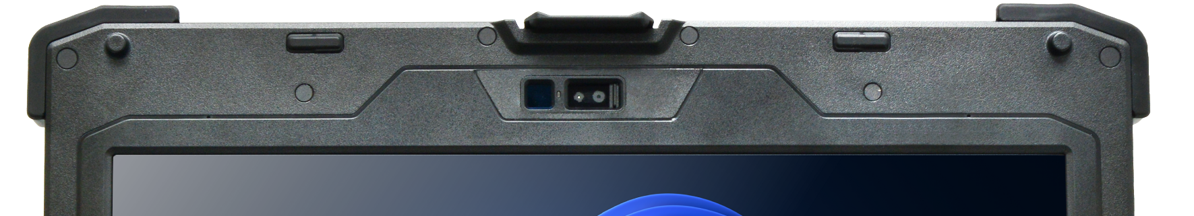
IMPROVED SECURITY WITH WINDOWS HELLO
UTILIZE the Power of biometrics-based TECHNOLOGY
Z14I supports Windows Hello face authentication. The new Z14I is equipped with a near infrared (IR) camera with facial recognition capability to authenticate and unlock Windows devices. Near infrared camera provides consistent image sensing capability in various ambient light environments, enabling users to login to Windows securely.
Windows Hello
Face Authentication

Slide 26
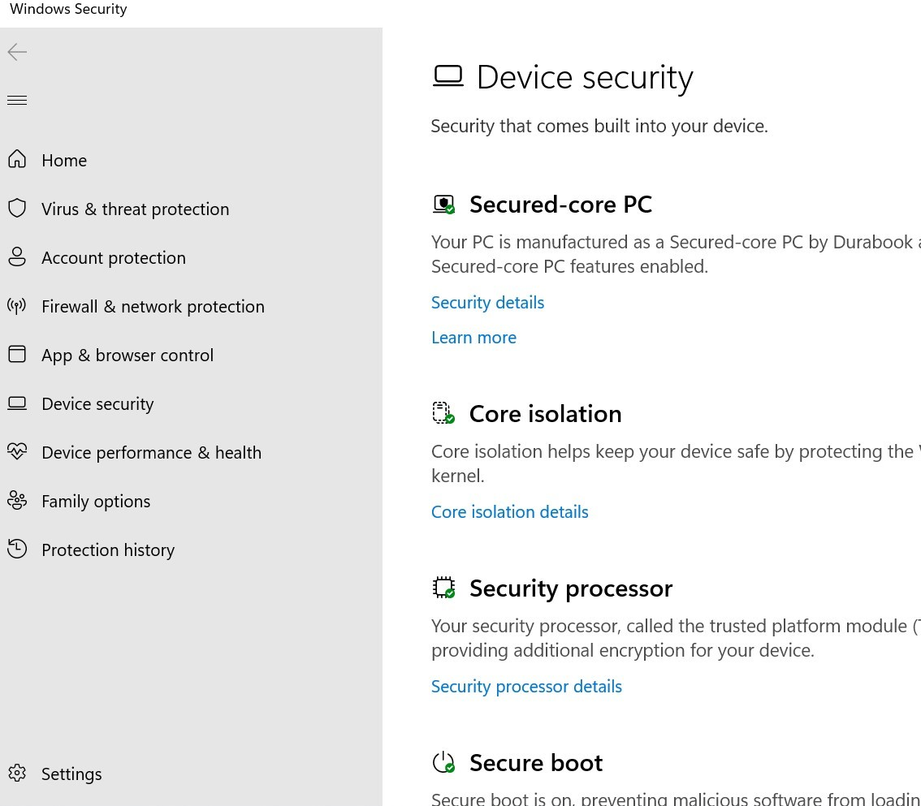
ELEVATE PROTECTION WITH SECURED-CORE PC
SupportING WINDOWS HELLO
*Secured-core PC is project base
Multifactor Authentication (MFA)
    Capacitive Fingerprint Reader
    Camera for Windows Hello facial recognition
    Smart Card reader
    LF/HF-RFID reader
Sniff out any tampering bootups
    TPM2.0 prevents tampering or malicious attacks.

Slide 27

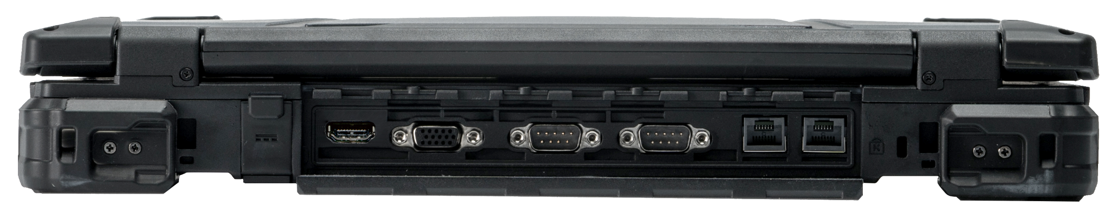
Z14I ANATOMY
2MP CAMERA WITH PRIVACY SHUTTER
OPTIONAL 5MP IR CAMERA FOR WINDOWS HELLO
FRONT
BACK
14.0” 1200 NITs SUNLIGHT READABLE DISPLAY
2x RS-232/422/485
(SERIAL PORT)
KENSINGTON
LOCK
2x PROGRAMMABLE KEYS
DC-IN
VGA
2x RJ-45
OPTIONAL FINGERPRINT
HDMI 2.1

Slide 28
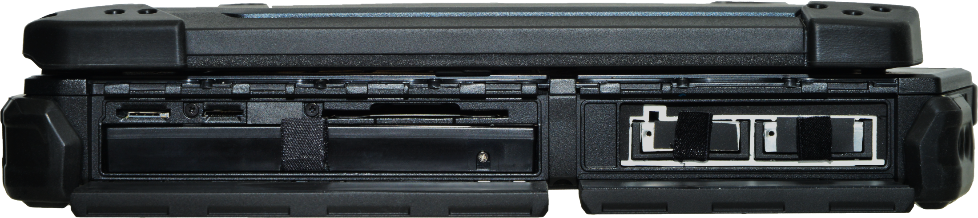
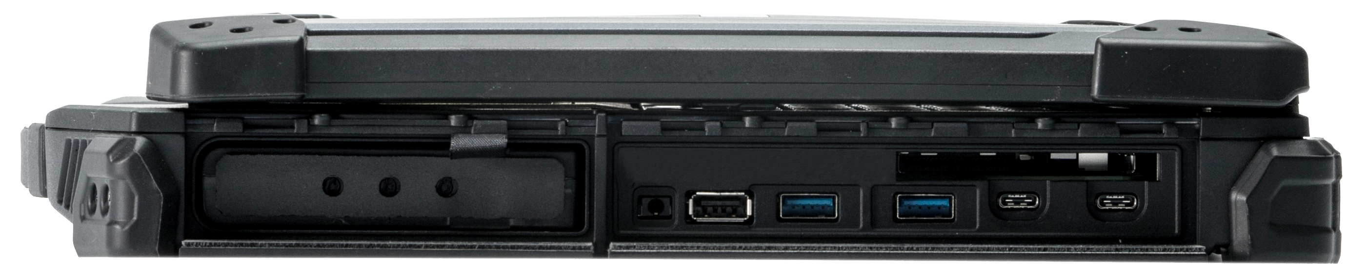
Z14I ANATOMY
LEFT
RIGHT
NANO SIM CARD
CAC/SMARTCARD READER
AUDIO IN/OUT
EXPRESSCARD 54
MICRO SD CARD
2x QUICK-RELEASE NVME PCIE SSD STORAGE DRIVES
SWAPPABLE MAIN BATTERY
USB 2.0
2x THUNDERBOLT 4
ODD
OPTIONAL 2ND BATTERY
OPTIONAL 3RD STORAGE (SATA SSD)
1x USB 3.2 Gen 2 (Type A)
1x USB 3.2 Gen 1 (Type A)

Slide 29
Accessories

Slide 30
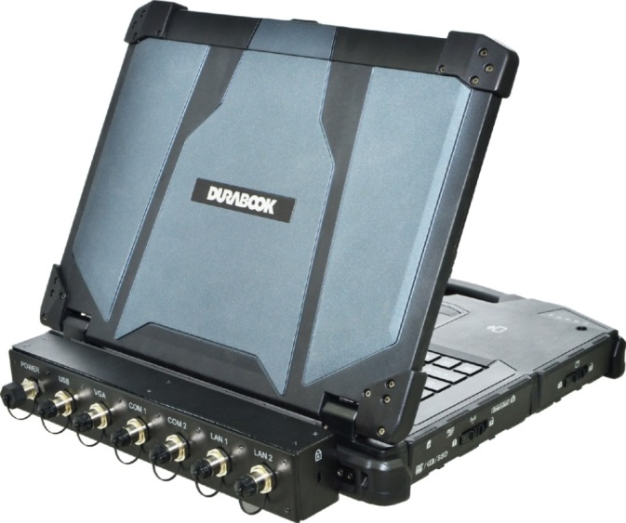
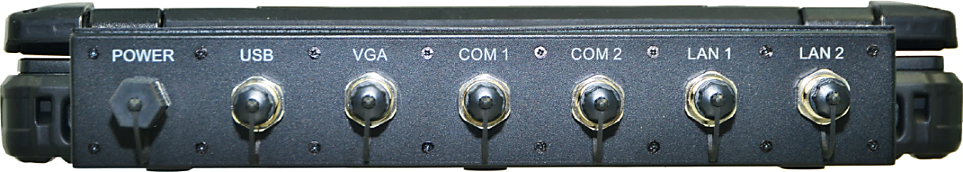
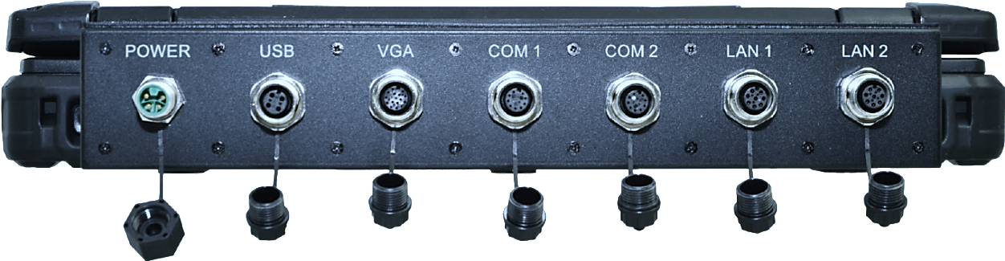
MILITARY GRADE CONNECTORS
Purpose-built M12 military-grade connectors
for 7 I/O interfaces.
Custom-Built: Enhanced flexibility for
MIL-STD-38999 connectors.
More rugged than ever.
Applications:
  Industrial automation use
  Military vehicle use
  Waterproof connector use
  Automotive diagnostic use
  Exploration Use
I/O Interfaces
VGA x 1
RS-232 x 2
RJ-45 x 2
DC in x 1
USB 2.0 x 1

Slide 31
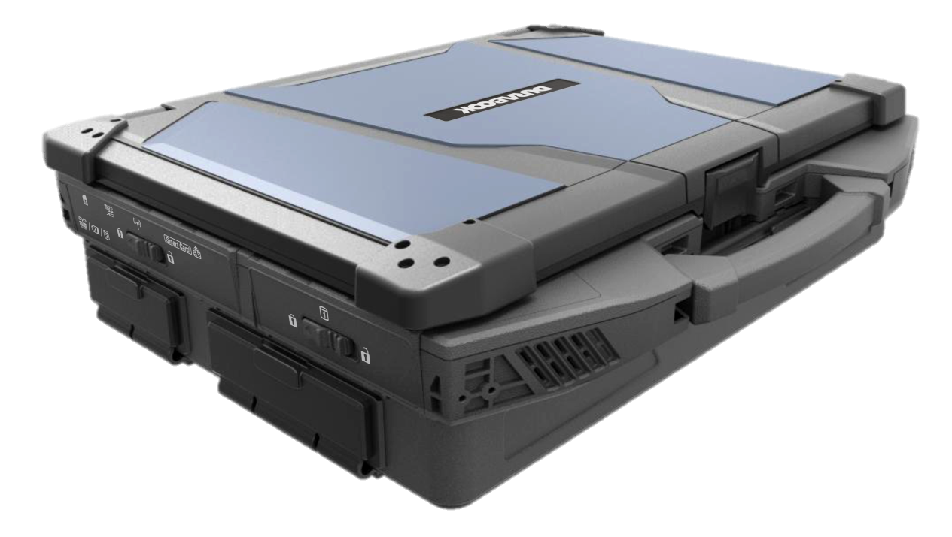
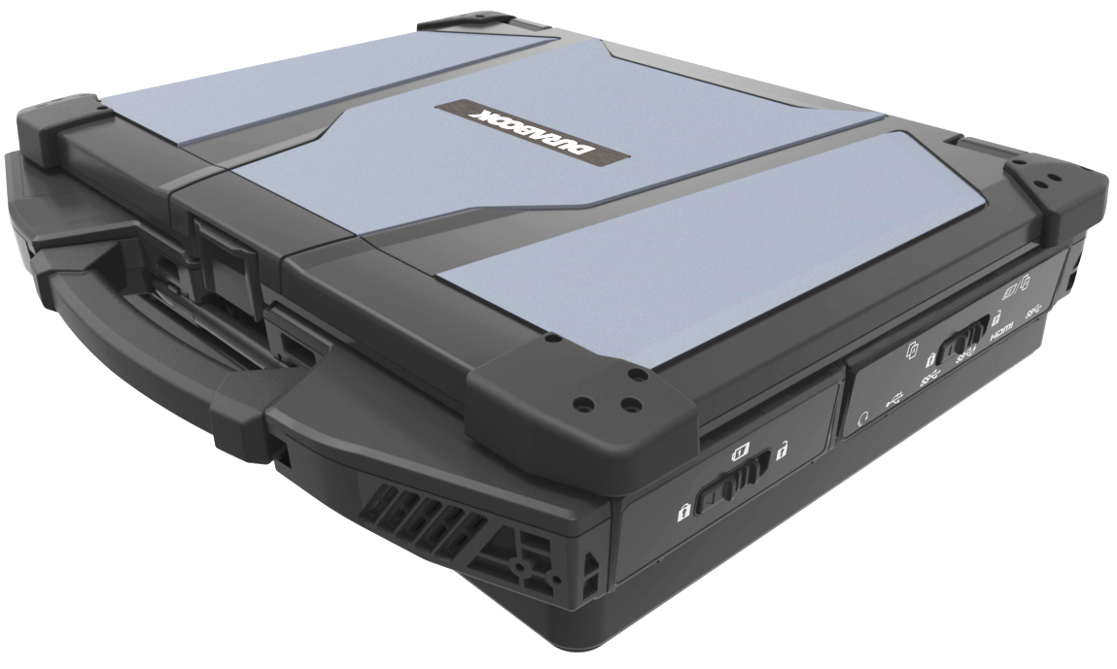
INFINITE POSSIBILITIES
A Working Server
Additional Discrete VGA
Multiple PCIe 3.0 interface connections
Graphics enhancement

Slide 32
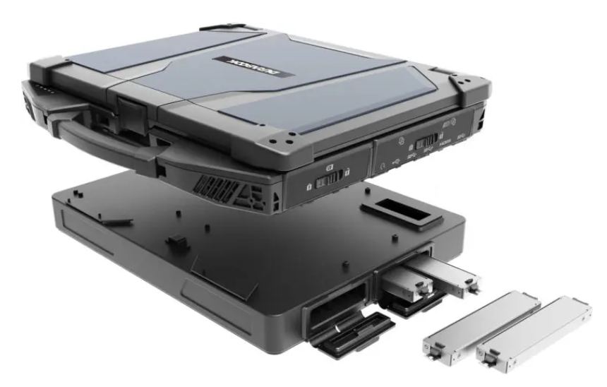
TURN TO A MOBILE SERVER
The expansion box is one of the most powerful enhancement capability of the Z14I.
From a working station to a working server, the expansion box provides two compartments with PCIe interface for various solution builds.
Field installed with simple and easy
guideline to become a powerful
working station.
Support RAID 0, 1, 5, 10
Support SATA SSD

Slide 33
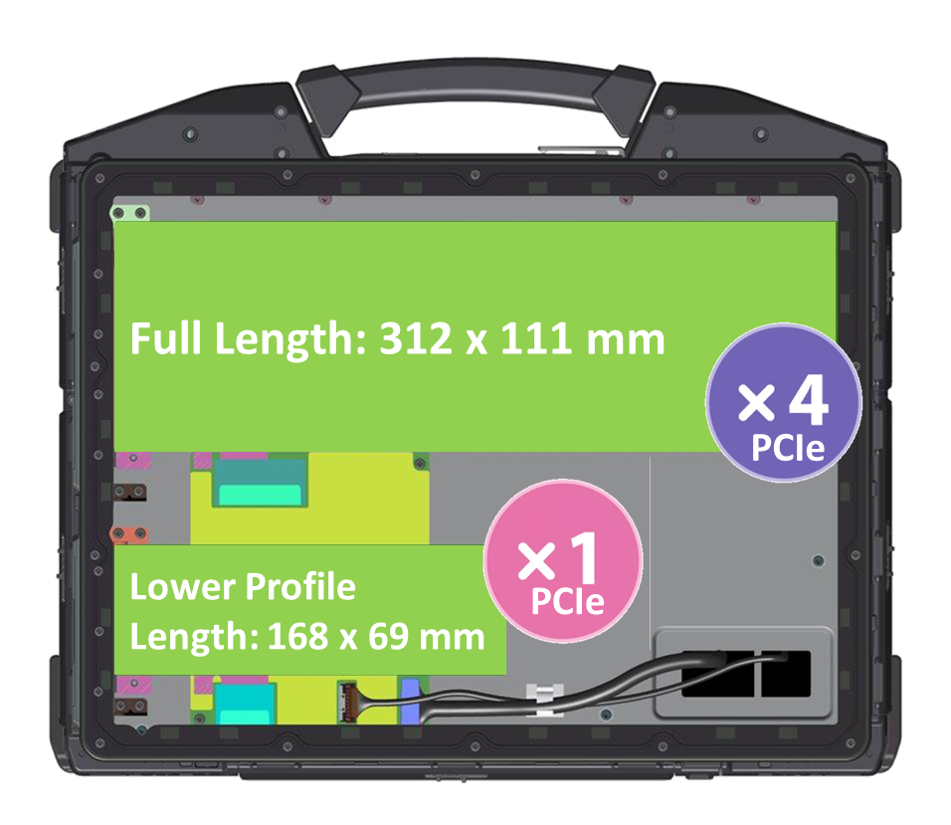
EXPANSION CAPABILITY
One BOX. Endless POSSIBILITIES.
Unlimited expansion capability with
2 slots of PCIe interface connections:
Slot 1: Full-Length PCIe Card
Interface: PCIe 3.0 X 4
Dimension:
312 x 111 mm (12.2 x 4.3 inches)
Slot 2: Low-Profile PCIe Card
Interface: PCIe 3.0 X 1
Dimension:
168 x 69 mm (6.6 x 2.7 inches)

Slide 34
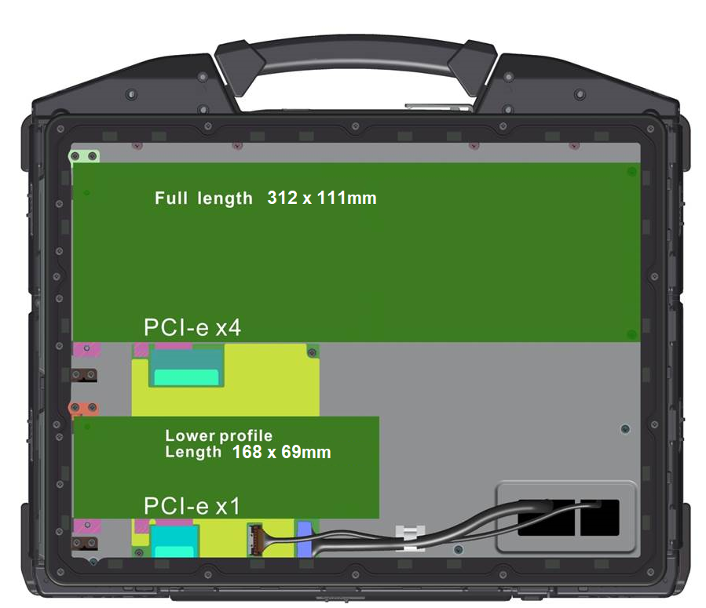
RESIST EXTERNAL INFLUENCES
Environmental:
IP65 protection
Temperature:
Operation: -20°C ‒ 60°C
Storage: -50C – 70°C
Humidity: ≦ 95 %
without condensation
Physical Box Spec:
Weight: 0.9kg
Dimension: 356mm (L) x 280mm (W) x 36mm (H)
280 mm
356 mm

Slide 35
PROVIDE MORE FLEXIBILITY THAN EVER
With PCIe x 4 and PCIe x 1, the expansion box gives the Z14I laptop more flexibility than ever, while staying mobile and portable.
Provide multiple build capabilities for end customers:
Additional I/O ports,
RAID configuration by using additional SSDs,
Video & Audio PCIe capture card,
Other custom PCIe cards.

Slide 36

ADDITIONAL GRAPHICS ENHANCEMENT
Performance Features:
NVIDIA® discrete graphic cards - NVIDIA® RTX A500
IP65 Protection
Temperature:
  Operation: -20°C ‒ 60°C
  Storage: -50°C – 70°C
Humidity: ≦ 95 %
without condensation
Physical Box Spec:
Weight: 1.26kg
Dimension: 342mm (L) x 260mm (W) x 28mm (H)

Slide 37


EASY FIELD INSTALLATION
Z14I
Z14I + Expansion Box
Connection via discrete opening
by simply removing the door cover.

Slide 38




OTHER ACCESSORIES
2x USB3.0
2x USB2.0
1x RJ-45
1x DP
1x HDMI
1x VGA
1x RS-232
1x Headphone
1x Mic
1x DC-in
2-Bay Battery Charging Station
Office Dock
8-Bay Battery Charging Station
Vehicle Dock

Slide 39
 | DURABOOK Z14I NEW | DURABOOK Z14I
Drop | MIL-STD-810H, 6' drop | MIL-STD-810H, 6' drop
IP rating | IP 66 | IP 65
Display | 14” FHD (1920 x1080) with 1,200 nits touch screen display | 14” FHD (1920 x1080) with 1,000 nits touch screen display
CPU | Intel® Core™ Ultra Series 1; Support vPro | 11th Generation Intel® Core™ i5-1135G7 (2.4GHz -4.2GHz) / i5-1145G7 (2.6GHz -4.4GHz) /i7-1165G7 (2.8GHz -4.7GHz) ) /i7-1185G7 (3GHz -4.8GHzv
Graphic | Intel Iris Xe Graphics - Optional NVIDIA RTX A500 | Intel Iris Xe Graphics - Optional NVIDIA GEFORCE GTX 1050
Storage | 256GB/512GB/1TB/2TB NVMe PCIe SSD - Optional 2nd NVME - Optional OPAL 2.0 SSD - Optional 3rd media-bay storage (2.5” SATA SSD) | 256/512GB/1TB NVME PCIe SSD - Optional 256/512GB/1TB SATA SSD - Optional OPAL 2.0 SSD - Optional 2nd/3rd storage (SATA SSD)
RAM | 8GB up to 64GB DDR5 | 8GB up to 64GB DDR4
I/O Interface | Thunderbolt 4 (type C) x 2, USB 3.2 Gen2 (type A) x 1 w/ power share, USB 3.2 Gen1 (type A) x 1, USB 2.0 (type A) x 1, Audio in/out (combo jack) x 1, microSD card x 1, 10/100/1000 Ethernet (RJ45) x 2, VGA x 1, HDMI 2.1 x 1, Serial port (RS232/RS422/ RS485: D-sub, 9-pin) x 2, Docking connector (41-pin Pogo) x 1, Dual SIM (Nano SIM & eSIM), Smart card reader x 1, ExpressCard 54 x1, DC-In jack x 1, Optional RF antenna pass-through for GPS, WWAN, and WLAN | Thunderbolt 4 x1, USB 3.2 Gen2 (type A) x 1 w/ power share, USB 3.2 Gen1 (type A) x 1, USB 3.2 Gen2 (type C+DP) x1, USB 2.0 (type A) x1, Audio in/out Combo x1, micro SD card, RJ-45 x2, VGA x1, HDMI x1, RS-232 x2, Docking connector x1, SIM card x1, DC in Jack x1, Smart card x1, PCMCIA/Express Card x1 - Optional RF antenna pass-through
Camera | - 2.0 MP with Shutter Design - Optional 5.0 MP Windows Hello camera | - 2.0 MP with Shutter Design
Media Bay | Optional ODD or 2nd battery or 3rd SSD (2.5” SATA) | Optional ODD or 2nd battery or 3rd SSD
Expansion box | - Optional PCl-Express 3.0 (2 slots) - Optional discrete VGA - Optional storage extension with RAID 0/1/5/10 - Optional military grade connectors | Optional PCl-Express 3.0 (2 slots) Optional discrete VGA Optional storage extension with RAID 0/1/5/10 Optional military grade connectors
Wireless | - Intel Wi-Fi 7 BE200 - Bluetooth v5.4 - Optional 4G LTE, 5G | - Intel Wi-Fi 6 AX201, Bluetooth v5.2 - Optional 4G LTE
Battery | 12.5 hrs (up to 21.5 hrs) | 12.5 hrs (up to 21.5 hrs)

Slide 40
 | DURABOOK Z14I | Market Solution G (B360) | Market Solution D (7424) | Market Solution D (7330)
Drop | MIL-STD-810H, 6' drop | MIL-STD-810H, 6' drop | MIL-STD-810G, 3' drop | MIL-STD-810H, 6' drop
IP rating | IP 66 | IP 66 | IP 65 | IP 65
Display | 14” FHD (1920 x1080) 1200 nits sunlight readable display with capacitive multi-touch screen | 13.3” FHD (1920 x 1080) with 1400 nits LumiBond® display with multi-touch screen | 14” FHD (1920x1080) with up to 1000nits sunlight viewable screen | 13.3” FHD (1920x1080) with 1400nits sunlight viewable screen
CPU | Intel® Core™ Ultra Series 1; Support vPro | 12th Generation Intel® Core™ Intel® Core™ i5-1250P vPro processor to 4.4GHz/ i7-1260P processor up to 4.7GHz/ i7-1270P vPro processor up to 4.8GHz/ i7-1280P vPro processor up to 4.8GHz | 8th Generation Intel® Core™ i5-8350U (1.7GHz) / i7-8650U (1.9GHz); Support vPro. | 11th Generation Intel® Core™ i5-1135G7 (2.4GHz -3.8GHz) / i5-1145G7 (2.6GHz – 4.0GHz)/ i7-1185G7 (3.0GHz-4.3GHz); Support vPro.
Graphic | Intel Iris Xe Graphics - Optional NVIDIA RTX A500 | Intel Iris Xe Graphics | Intel® UHD Graphics 620 - Optional AMD 540/RX540 | Intel Iris Xe Graphics
Storage | 256GB/512GB/1TB/2TB NVMe PCIe SSD - Optional 2nd NVME - Optional OPAL 2.0 SSD - Optional 3rd media-bay storage (2.5” SATA SSD) | Main Storage: 256GB/512GB/1TB/2TB NVMe SSD 2nd Storage: 256GB/512GB/1TB/2TB NVMe SSD | 128/256GB NVME PCIe SSD - Optional 512GB/1TB PCIe SSD - Optional Encrypting SSD - Optional 2nd/3rd storage (SATA SSD) | 128/256GB NVME PCIe SSD - Optional 512GB/1TB PCIe SSD - Optional Encrypting SSD
RAM | 8GB up to 64GB DDR5 | 8GB up to 64GB DDR4 | 8GB up to 32GB DDR4 | 8GB up to 32GB LPDDR4
I/O Interface | Thunderbolt 4 (type C) x 2, USB 3.2 Gen2 (type A) x 2, USB 2.0 (type A) x 1, Audio in/out (combo jack) x 1, microSD card (microSDXC) x 1, 10/100/1000 Ethernet (RJ-45) x 2, VGA port (D-sub,15-pin) x 1, HDMI 2.1 port (type A) x 1, Serial port (RS232/RS422/RS485: D-sub, 9-pin) x 2, Docking connector (41-pin Pogo) x 1, Dual SIM (Nano SIM & eSIM), Smart card reader x 1, ExpressCard 54 x 1, DC-In jack x 1, Optional RF antenna pass-through for GPS, WWAN, and WLAN | Audio in/out Combo x 1, DC in x 1, USB 3.2 Gen 2 Type-A x 1, PowerShare USB 3.2 x 1, Thunderbolt 4 x 1, RJ45 x 1, RJ45 x 1, HDMI x 1, Docking connector x 1 - Optional: SIM card slot - Optional RF antenna pass-through - Optional: Serial port (D-sub) x1 + VGA or Serial port (D-sub) x1 + Display port x 1 or Serial port (D-sub) x1 + VGA x1 + RJ45 or Serial port (D-sub) x1 + DP + RJ45 | USB 3.1 (type A) x3, USB 3.1 (type C) x1, (support PD), Docking connector x1, HDMI x1, RJ-45 x1, RS-232 x1, SD and SIM card x1, Smart card x1, Audio Jack, - Optional 2nd RJ-45, 2nd Serial, VGA, Display port or Fischer USB - Optional PCMCIA or Express Card | Thunderbolt 4 x1, USB 3.2 Gen1 x1, USB 3.2 Gen1 (with power share) x1, USB 3.2 Gen2 (type C+PD) x1, HDMI x1, RJ-45 x1, RS-232 x1, Combo headphone & microphone, Mircro SD card, Nano SIM card - Optional: Thunderbolt 4 - Optional: Smart card reader - Optional: RJ-45/USB Type A/Fischer USB 3.0 9 pin - Optional: Contactless card reader - Optional: Express card reader
Media Bay | Optional ODD / 2nd battery / 3rd SSD (2.5” SATA) | NA | Optional ODD | NA
Wireless | - Intel Wi-Fi 7 BE200 - Bluetooth v5.4 - Optional 4G LTE & 5G | - Intel W-Fi 6E AX211, 802.11ax - Bluetooth v5.3 - Optional 4G LTE | - Optional Intel Dual Band Wireless AC 8265 - Bluetooth v4.2 - 4G LTE | - Intel Wi-Fi AX210 - Optional Bluetooth - Optional 4G LTE
Battery | 12.5 hrs (up to 21.5 hrs) | NA | 14 hrs | 25 hrs

Slide 41
 | DURABOOK Z14I | Market Solution G (B360 Pro) | Market Solution P (40)
Drop | MIL-STD-810H, 6' drop | MIL-STD-810H, 6' drop | MIL-STD-810H, 6' drop
IP rating | IP 66 | IP 66 | IP 66
Display | 14” FHD (1920 x1080) 1200 nits sunlight readable display with capacitive multi-touch screen | 13.3” FHD (1920 x 1080) with 1400 nits LumiBond® display with multi-touch screen | 14” FHD (1920 x 1080) with 1200 nits capacitive gloved touch
CPU | Intel® Core™ Ultra Series 1; Support vPro | 12th Generation Intel® Core™ Intel® Core™ i5-1250P vPro processor to 4.4GHz/ i7-1260P processor up to 4.7GHz/ i7-1270P vPro processor up to 4.8GHz/ i7-1280P vPro processor up to 4.8GHz | 11th Generation Intel® Core™ - Intel® Core™ i5-1145G7 vPro™ ( up to 4.4GHz) - Intel® Core™ i7-1185G7 vPro™ ( up to 4.8GHz)
Graphic | Intel Iris Xe Graphics - Optional NVIDIA RTX A500 | Intel Iris Xe Graphics Optional: NVIDIA® GeForce® GTX1650 4GB discrete graphics controller | Intel® Iris® Xe Graphics Intel® UHD Graphics AMD Dedicated Graphics
Storage | 256GB/512GB/1TB/2TB NVMe PCIe SSD - Optional 2nd NVME - Optional OPAL 2.0 SSD - Optional 3rd media-bay storage (2.5” SATA SSD) | Main Storage: 256GB/512GB/1TB/2TB NVMe SSD 2nd Storage: 256GB/512GB/1TB/2TB NVMe SSD Optional multimedia bay storage : 1TB / 2TB SATA SSD | 512GB, 1TB or 2TB quick-release OPAL NVMe SSD - Optional 2nd storage 512GB or 1TB SATA SSD
RAM | 8GB up to 64GB DDR5 | 8GB up to 64GB DDR4 | 16GB up to 64GB DDR4
I/O Interface | Thunderbolt 4 (type C) x 2, USB 3.2 Gen2 (type A) x 2, USB 2.0 (type A) x 1, Audio in/out (combo jack) x 1, microSD card (microSDXC) x 1, 10/100/1000 Ethernet (RJ-45) x 2, VGA port (D-sub,15-pin) x 1, HDMI 2.1 port (type A) x 1, Serial port (RS232/RS422/RS485: D-sub, 9-pin) x 2, Docking connector (41-pin Pogo) x 1, Dual SIM (Nano SIM & eSIM), Smart card reader x 1, ExpressCard 54 x 1,DC-In jack x 1, Optional RF antenna pass-through for GPS, WWAN, and WLAN | Audio in/out Combo x 1, DC in x 1, USB 3.2 Gen 2 Type-A x 1, PowerShare USB 3.2 x 1, Thunderbolt 4 x 1, RJ45 x 1, RJ45 x 1, HDMI x 1, Docking connector x 1, - Optional: SIM card slot - Optional RF antenna pass-through - Optional: Serial port (D-sub) x1 + VGA or Serial port (D-sub) x1 + Display port x 1 or Serial port (D-sub) x1 + VGA x1 + RJ45 or Serial port (D-sub) x1 + DP + RJ45 or Serial port (D-sub) x2 + VGA or Serial port (D-sub) x2 + DP or Serial port (D-sub) x2 +VGA + RJ45 or Serial port (D-sub) x2 + DP + RJ45 | - Thunderbolt 4 x1, USB A x2, Micro SDXC, HDMI, RJ45, Audio in/out, dual SIM Optional USB A x2 Optional VGA Optional 2nd RJ45 Optional Serial D-sub 9-pin Optional Smart card
Media Bay | Optional ODD / 2nd battery / 3rd SSD (2.5” SATA) | NA | Optional DVD Drive/ Barcode Reader/ 512GB/1TB 2nd SSD
Expansion box | - Optional PCl-Express 3.0 (2 slots) - Optional discrete VGA - Optional storage extension with RAID 0/1/5/10 - Optional military grade connectors | - Smart card reader x 1 - Optional: SD card reader x 1 - Optional: Discrete graphics controller, or PCMCIA Type II, or ExpressCard54 - Optional: 1D/2D imager barcode reader' - Optional: DVD super multi drive, or Blu-Ray super multi drive, or 3rd storage - Optional: 3rd battery | - 2nd Battery
Wireless | - Intel Wi-Fi 7 BE200 - Bluetooth v5.4 - Optional 4G LTE & 5G | - Intel W-Fi 6E AX211, 802.11ax - Bluetooth v5.3 - Optional 4G LTE | - Intel® Wi-Fi 6 AX201, Bluetooth v5.1 - Optional 4G LTE & 5G
Battery | 12.5 hrs (up to 21.5 hrs) | NA | 18 hrs up to 36 hrs

