Slide 1
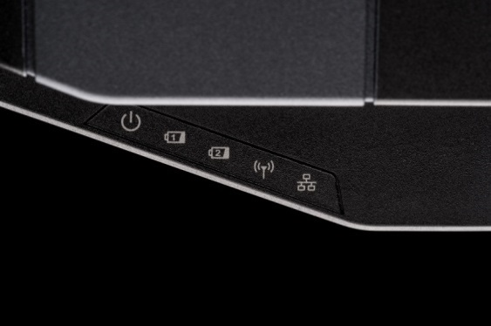
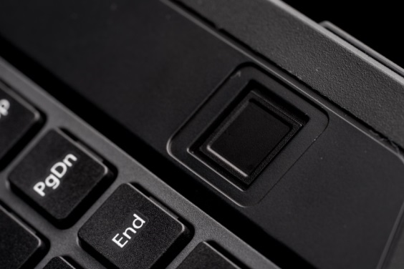
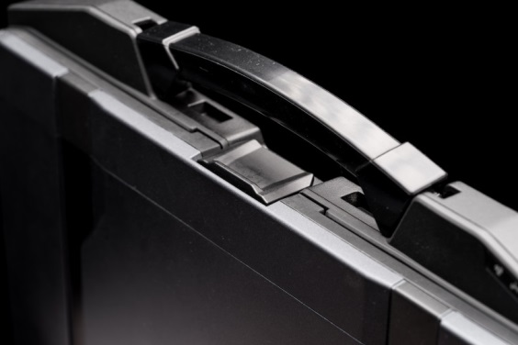
DURABOOK S14I INTRODUCTION
DURABOOK MARKETING DIVISION

Slide 2
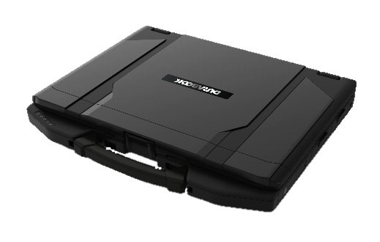
UNIQUE SELLING PROPOSITION
Extraordinary Computing Performance
Robust and Secure Inside Out
Endless Configuration Possibilities
Best For Outdoor Use
Intel® Meteor Lake Core™ Ultra U Processors
Embedded AI Boost NPU
Intel Iris Xe-LPG Graphics
Optional NVIDIA GPU/ AI Accelerator
IP53, 4’ Drop
MIL-STD 810H
Wide Range Temp (-29°C - 63°C)
Quick-Release Storage
Windows 11 Secured-Core PC
Windows Hello Camera
14” Full HD DynaVue Technology up to 1200 nits
Night Vision / Stealth Mode
Four Touch Modes
Dual Hot-Swappable Battery Technology
Long Lasting Battery with Battery charging protection
Abundant I/O Ports with
two Thunderbolt 4, up to three USB Type A, two RJ-45 & up to two RS-232 ports
Wi-Fi 7, BT5.4, 4G/5G, Dual SIM
Expansion options of discrete VGA, smart card reader, ExpressCard 54 & many more

Slide 3


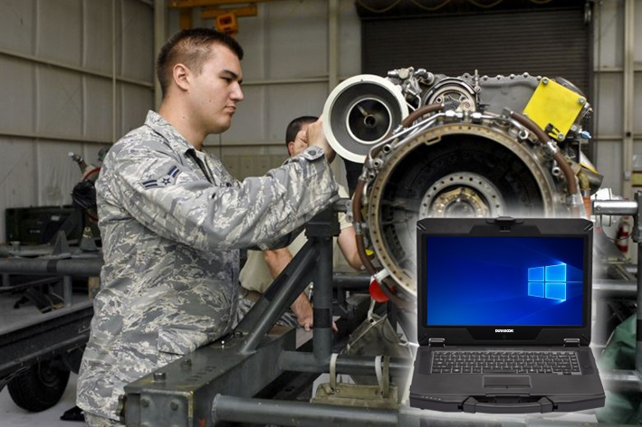

TARGETS & APPLICATIONS
Applications
Automotive
Field Service
Mapping/Dispatching
Recording System
Edge Computing
CAD Applications
Assets Management
Maintenance Diagnostic Tool
On-Site Project Management
Public Safety
Military/Government

Slide 4


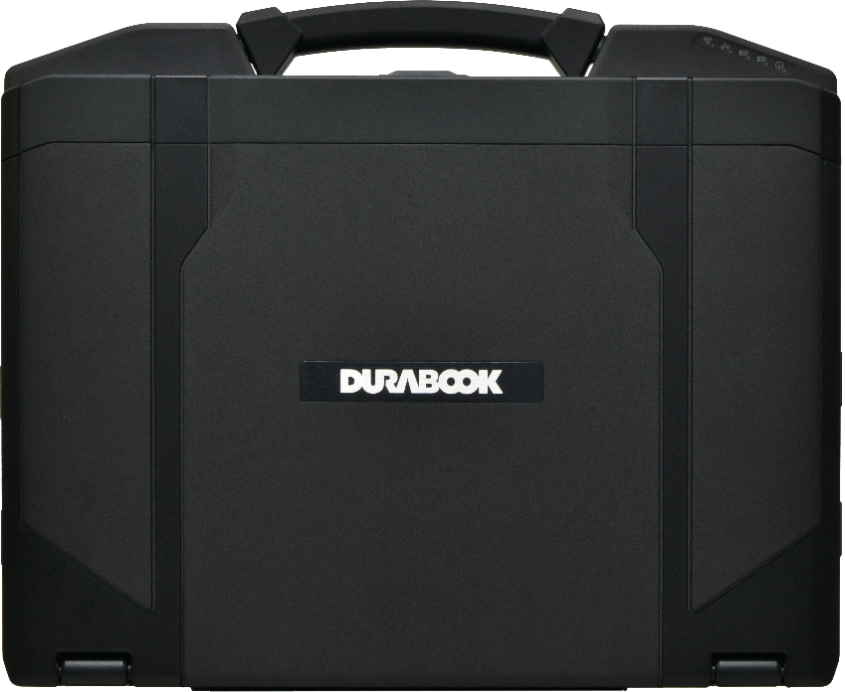
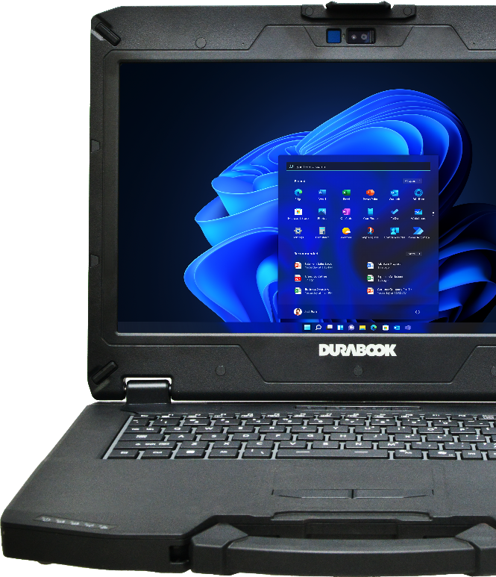
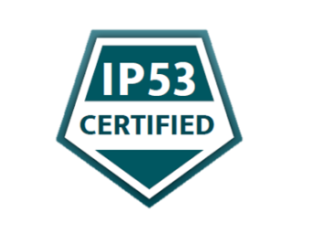



S14I FEATURES HIGHLIGHT
WORLD’S TOUGHEST SEMI-RUGGED LAPTOP
Intel® Core™ Ultra 5 125U up to 4.3 GHz/ Ultra 7 155U up to 4.8 GHz; with vPro Technology.
Embedded Intel® AI Boost NPU to optimize AI performance
14” FHD (1920 x1080) 1,200 nits DynaVue® sunlight readable display and optional capacitive multi-touch function
Removable quick-release batteries & storage drive
Dual Hot-Swappable battery design up to 32 hours
Windows 11 Secured-Core PC ready
Optional NVIDIA® RTX A500 Graphics / AI Accelerator
MIL-STD-810H, 4ft drop & IP53 certified

Slide 5


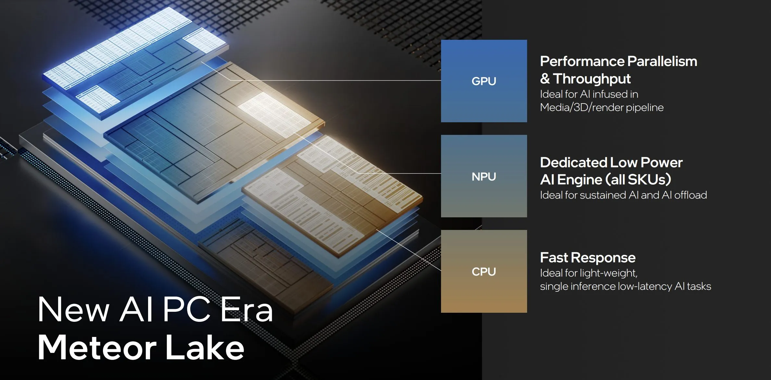
7nm
COMPUTING POWER WITH AI
14th generation CPU
S14’s Meteor Lake Core™ Ultra Processor, with 3 types of performance-tailored cores totaling to 12 cores, boasts a 12MB cache, achieving 37% higher performance than previous generation. Intel® Meteor Lake processor also offers true Hardware AI Acceleration with multi-compute engines, CPU + GPU + AI Boost NPU.
Manufactured with Intel 4 (7nm) semiconductor process, Core Ultra CPU offers 20% higher performance per watt than 11th Gen Tiger Lake 10nm CPU.
 | Intel® Core i5 1135G7 | Intel® Ultra 5 125U Meteor Lake | Intel® Ultra 7 155U Meteor Lake
Turbo Speed | Up to 4.2 GHz | Up to 4.3 GHz | Up to 4.8 GHz
# of Physical Cores | 4 Cores | 12 Cores | 12 Cores
Cache | 8MB | 12MB | 12MB
CPU Mark | 9,834 | 13,561 | 14,973

Slide 6
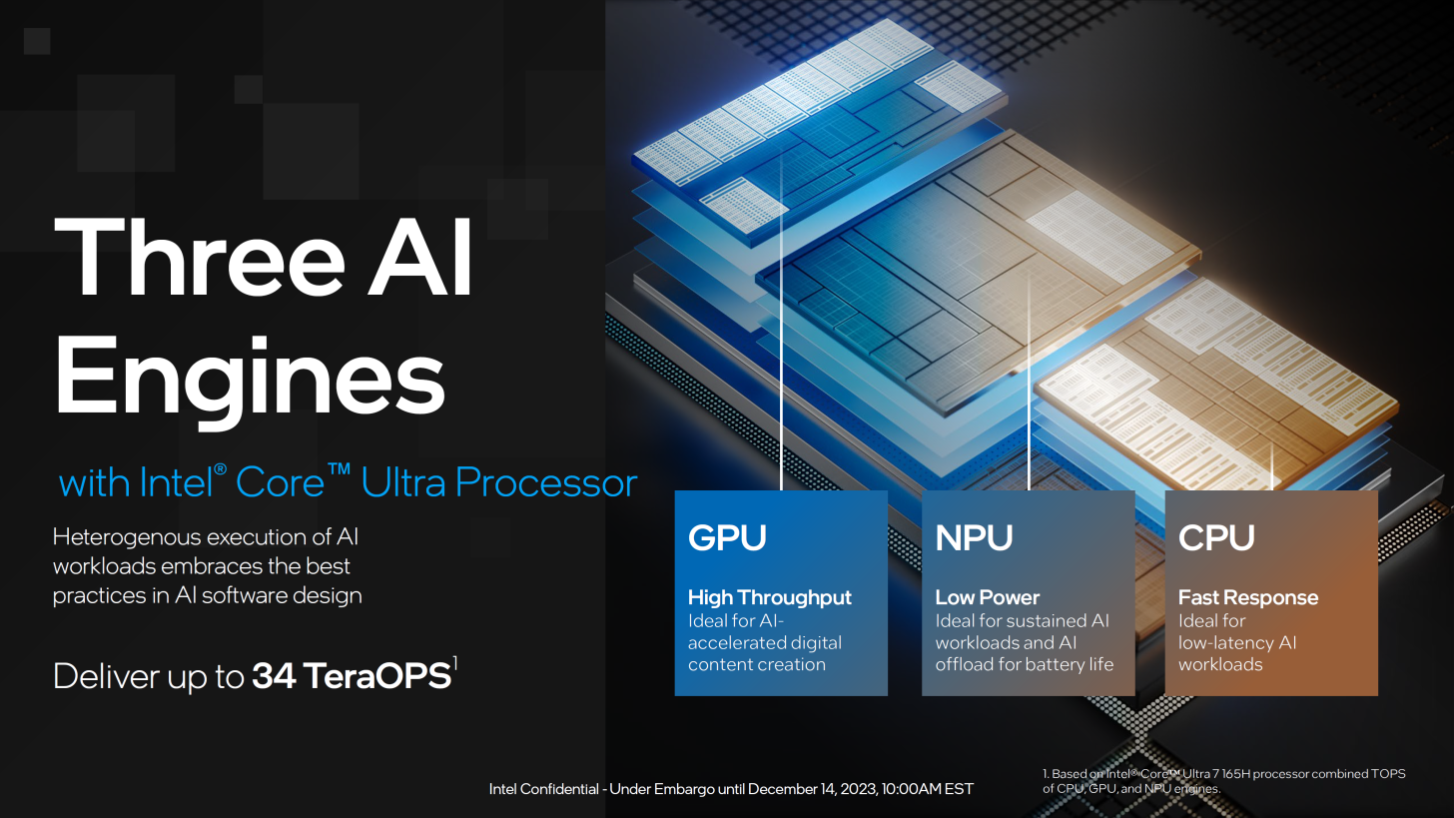
NEW PC LEVEL - INCREDIBLE AI
S14I with an Intel® Core™ Ultra processor, is Durabook’s first AI Ready PC with three distinct AI engines:
a NPU (Neural Processing Unit) optimized for AI operations, a GPU, and a CPU.
AI intensive computations are offload to dedicated NPU processor, freeing up CPU and GPU’s computing power to enhanced total platform performance.
Combined AI engines of CPU, NPU and GPU offering unprecedented AI computing power opens unlimited possibilities.

Slide 7
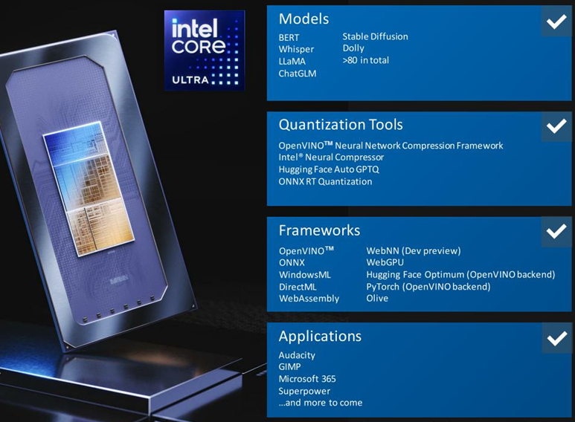
AI PC RIGHT AT YOUR FRONT
Intel® Core™ Ultra Processors run the latest LLMs, transformers and text-to-image workloads, helping you be more productive and creative.
Users may fully exploit AI on their PCs with Intel's support for hundreds of programs that already make use of it, making it the most expansive ISV ecosystem in the PC CPU market.

Slide 8
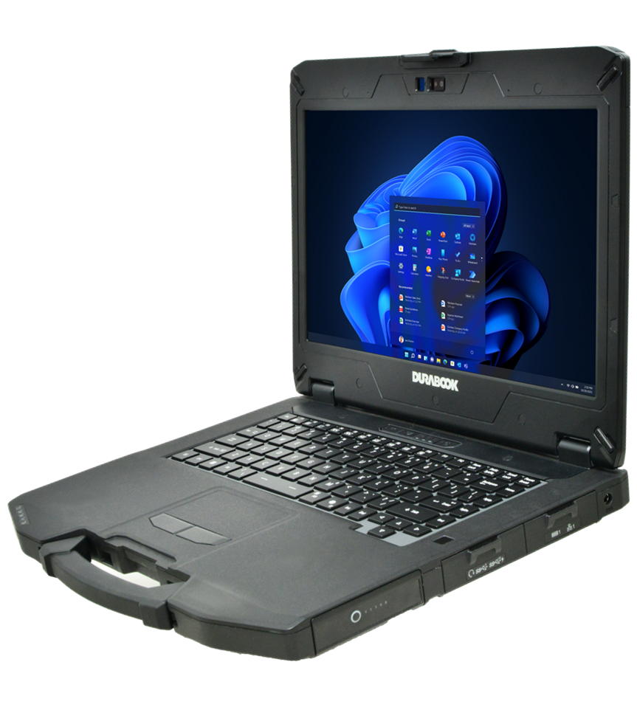
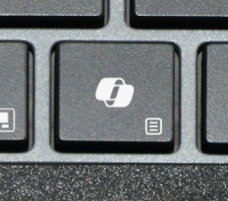

COPILOT - THE AI ASSISTANT AT WORK
Your everyday AI companion
Microsoft Copilot is an AI-powered assistant available in Windows 11.
It leverages the power of AI to boost productivity and unlock creativity.
Find answers and inspiration from the web.
Works within Microsoft 365 apps, documents, and conversations.
Integrates with security systems, data analysis, and business applications.
COPILOT KEY

Slide 9
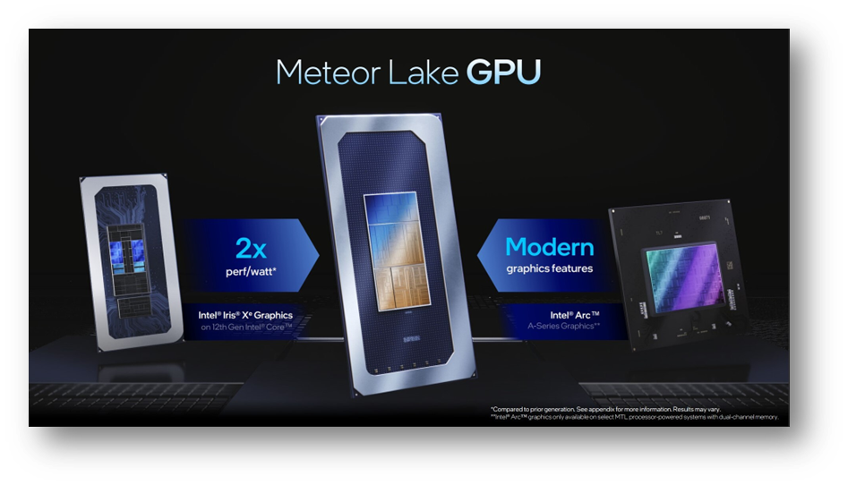
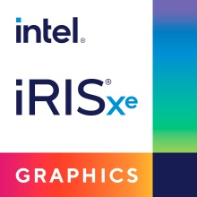

GRAPHICS PERFORMANCE
Intel® Iris Xe-LGA Graphics + NVIDIA RTX A500
The S14I comes with enhanced Intel® Xe-LPG Graphics with 4 Xe cores, delivering a 200% higher performance/watt result comparing to IRIS Xe graphics. Its 3D rendering performance is also 2.5x faster than UHD 620.
For professionals who run massive graphic computing, the S14I can also be built with optional discrete NVIDIA RTX A500, 6.5x tremendously faster 3D effective speed than UHD 620, delivering 100 TOPS in AI acceleration.
Source: PassMark

Slide 10

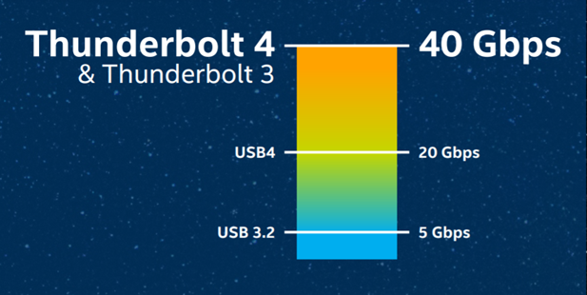
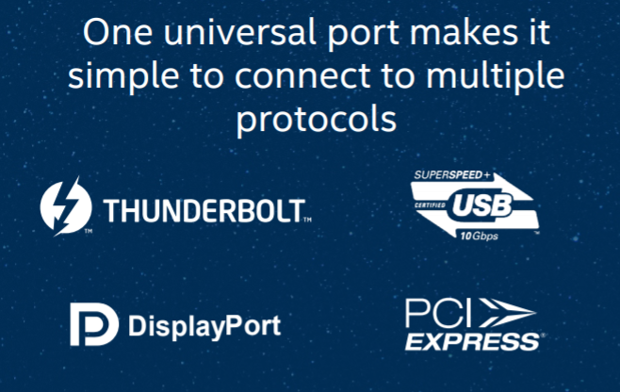
THUNDERBOLT™ 4 Technology
UNIVERSAL CABLE CONNECTIVITY
Thunderbolt 4 is the latest version of Intel's Thunderbolt line.
Thunderbolt 4 is more powerful and makes connecting the modern workspace more flexible and simpler than ever.
Delivers 40Gb/s of bandwidth
One port supports multiple protocols
  USB 4
  DisplayPort
  PCIe
Support up to 2x 4K displays
It is backwards compatible with Thunderbolt 3 & USB-C
Maximum flexibility for docking station
Bi-directional power
  Power share + power delivery (PD)

Slide 11
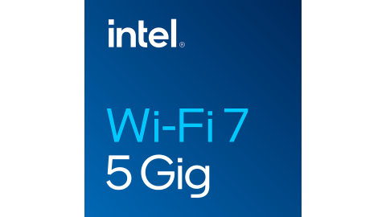

MAXIMUM CONNECTIVITY
INTEL® WI-FI 7 BE200
Intel® Wi-Fi 7 BE200, a revolution in Wi-Fi technology, provides advancement in connection speed, channel bandwidth, throughput and MLO (Multi-Link Operation).
Wi-Fi 7 provides Extremely High Throughput (EHT) and additional 320 MHz Channels.
Wi-Fi 7 BE200 has max. data transfer speed of 46 Gbps, 4.8x faster than Wi-Fi 6 AX201’s max speed of 9.6 Gbps
Wi-Fi 7 BE200 with Bluetooth® V5.4 provides data transfer range of up to 300 meters (= 984 ft)
Brand | Wireless Lan | Bluetooth | Wi-Fi Speed | Max Channel Bandwidth | Band
Durabook S14I New | BE200 | V5.4 | 46 Gbps | 320 MHz | 2.4 GHz + 5 GHz +6 GHz (Multi Link)
Market Solution P | AX201 | V5.2 | 9.6 Gbps | 160 MHz | 2.4 GHz or 5 GHz (Single Link)

Slide 12
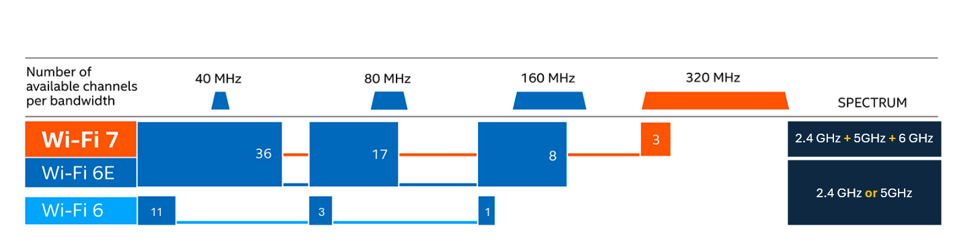
WI-FI 7 NEXT GENETATION CONNECTIVITY
Wi-Fi 7 offers a 6 GHz frequency band in addition to Wi-Fi 6’s 5 GHz and 2.4 GHz. Wi-Fi 7 also uses a unique new MLO (Multi-Link Operation) technology to transmits data by simultaneously connecting to two bands. The extended 6GHz spectrum and Multi-Link Operation offer higher data transfer speed, wider bandwidth and reduced interference.

Slide 13

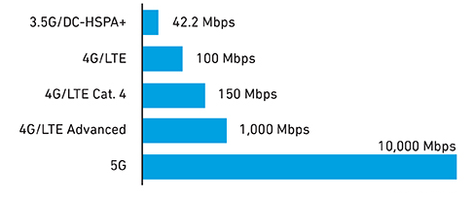
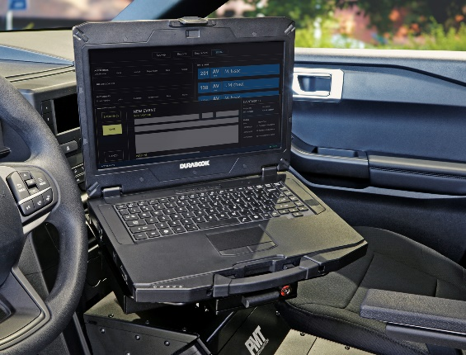


SEAMLESS CONNECTIVITY
Advanced wireless capabilities include cellular options of 4G LTE or 5G.
5G mobile connectivity offers ultrafast data transfer speed over previous generations of mobile networks, which is 100x fast than 4G LTE. Providing always-on high-speed connectivity for workers in the field with improved productivity anytime, anywhere.
Downlink Speeds by Technical Generation
GOVERNMENT SECTOR
S14I designed with u-blox NEO M9N module to provide high GPS accuracy.
And more, featured by RF Tri-pass-through (WIFI, WWAN, GPS), in-field professionals can connect to the remote database in real time.

Slide 14






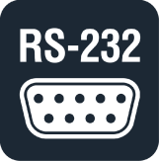
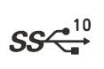
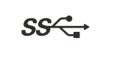

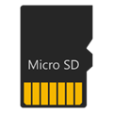

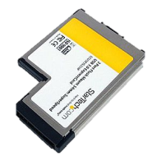
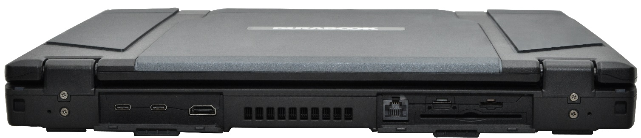
SPEAK ALL LANGUAGES
Thunderbolt 4 (Type C) x 2
USB 3.2 Gen 2 (Type A) x 1,
USB 3.2 Gen 1 (Type A) x 1
HDMI 2.1 x 1
RJ-45 x 2
RS-232 (support 422 & 485) x 1
Dual SIM (Nano SIM & eSIM)
microSD card reader
Optional LF/HF-RFID (NFC) reader
Optional fingerprint reader
Optional Smart Card/CAC reader*
Optional ExpressCard 54*
Optional 2nd RS-232 + 2nd USB 3.2 Gen 1*
HDMI
Support
Multiple
Displays
RJ-45
for Data
Transfer/
Server
Thunderbolt
4
Legacy
Device
Fingerprint
Data Access
Security
Smartcard
Data Access
Security
USB 3.2
Gen2
Type A
USB 3.2
Gen 1 Type A
4G LTE/ 5G
Connection
Quick Data
Exchange
LF/HF
RFID
Legacy
Device
* Mutual exclusive options

Slide 15

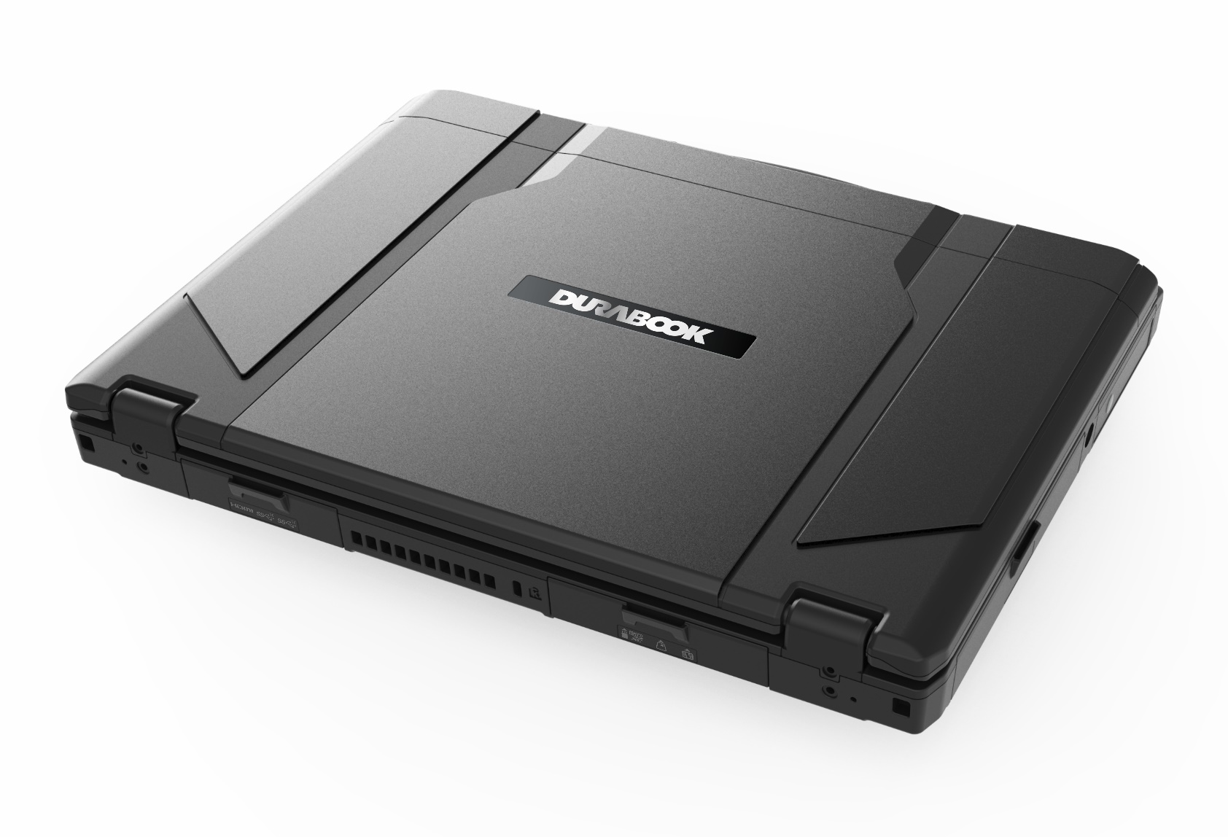
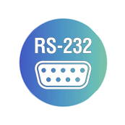





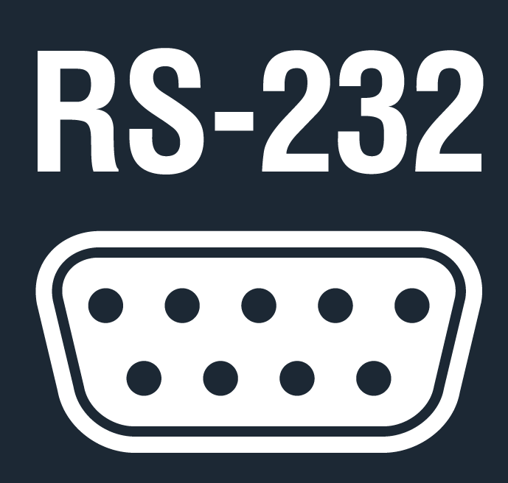

ALL THE RIGHT CONNECTIONS
Dual Thunderbolt 4
by default
Dual RJ-45 ports
by default
Dual RS-232 ports
(support 422/485)*
*
* 2nd port is optional.

Slide 16

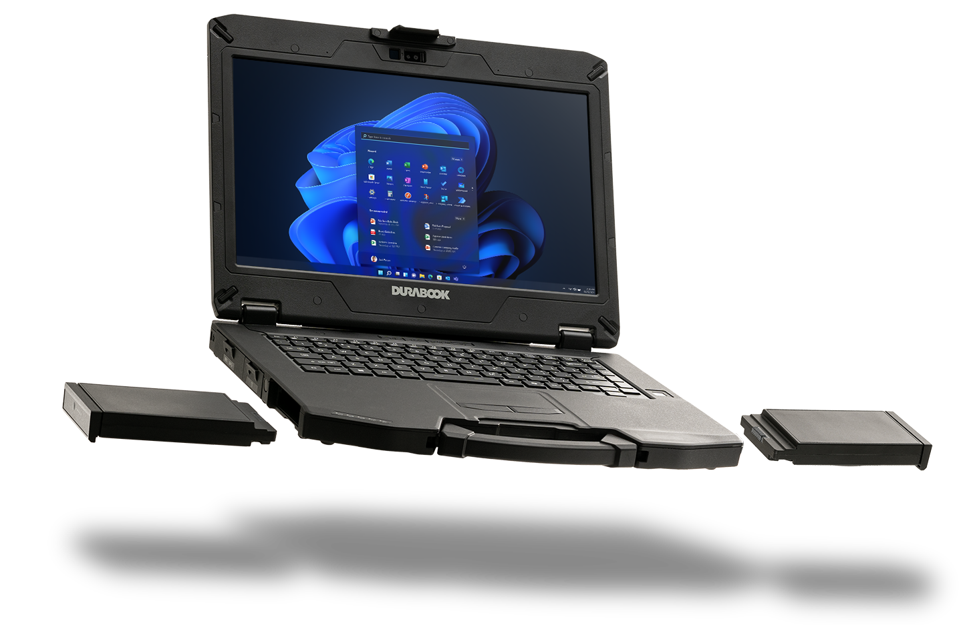
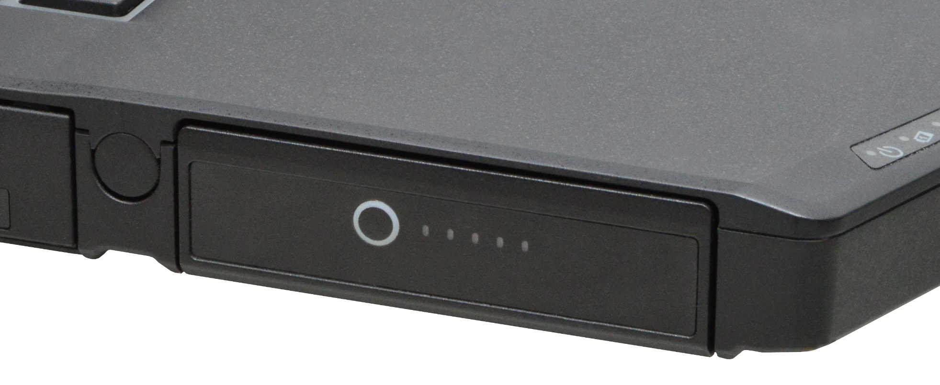
NON-STOP MOBILITY
Zero Downtime with Dual Hot-Swappable Technology
The most significant enhancement for the new S14I is the dual hot-swappable batteries technology with 5 minutes of time between battery changes.
Both battery packs are equipped with 5-LED power level indicator, providing instant battery status.
Designed to handle prolonged operation up to 16 hours with a single battery, the S14I will last up to 32 hours, when the S14I is running on dual battery mode.
5-LED Power Level Indicator

Slide 17

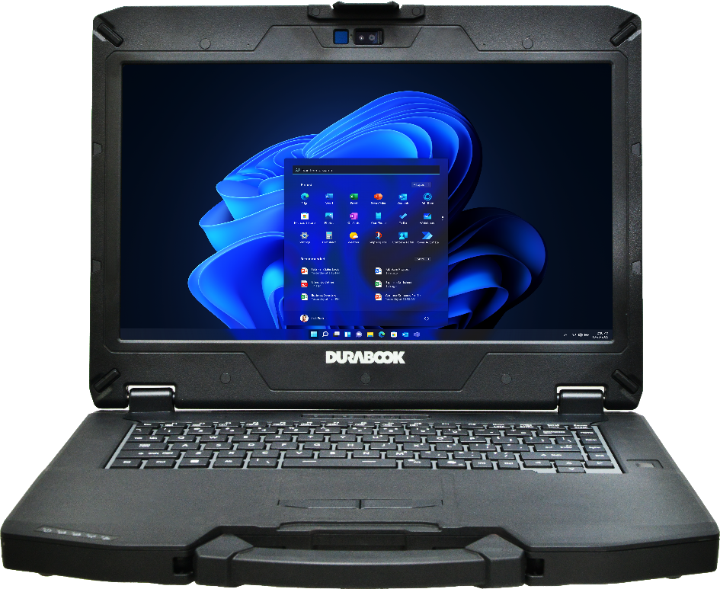
BATTERY CHARGING PROTECTION
To reduce battery aging, Durabook has developed four battery charging modes with enhanced charging algorithms for our customers to choose from.
4 Battery modes:
Regular Mode
In this mode the battery will be fully charged.
Optimized Battery Charging (OBC)
Battery charging will stop at 80% to reduce battery aging.
Temperature Control Mode (TCM)
To extend the lifetime of the battery, charging is
enhanced based on DURABOOK intelligent algorithm
and battery temperature.
DURA² Charging (D2C)
To maximize battery performance and lifespan, charging
is enhanced based on DURABOOK intelligent algorithm
and battery temperature. Battery charging will stop at 80%.

Slide 18
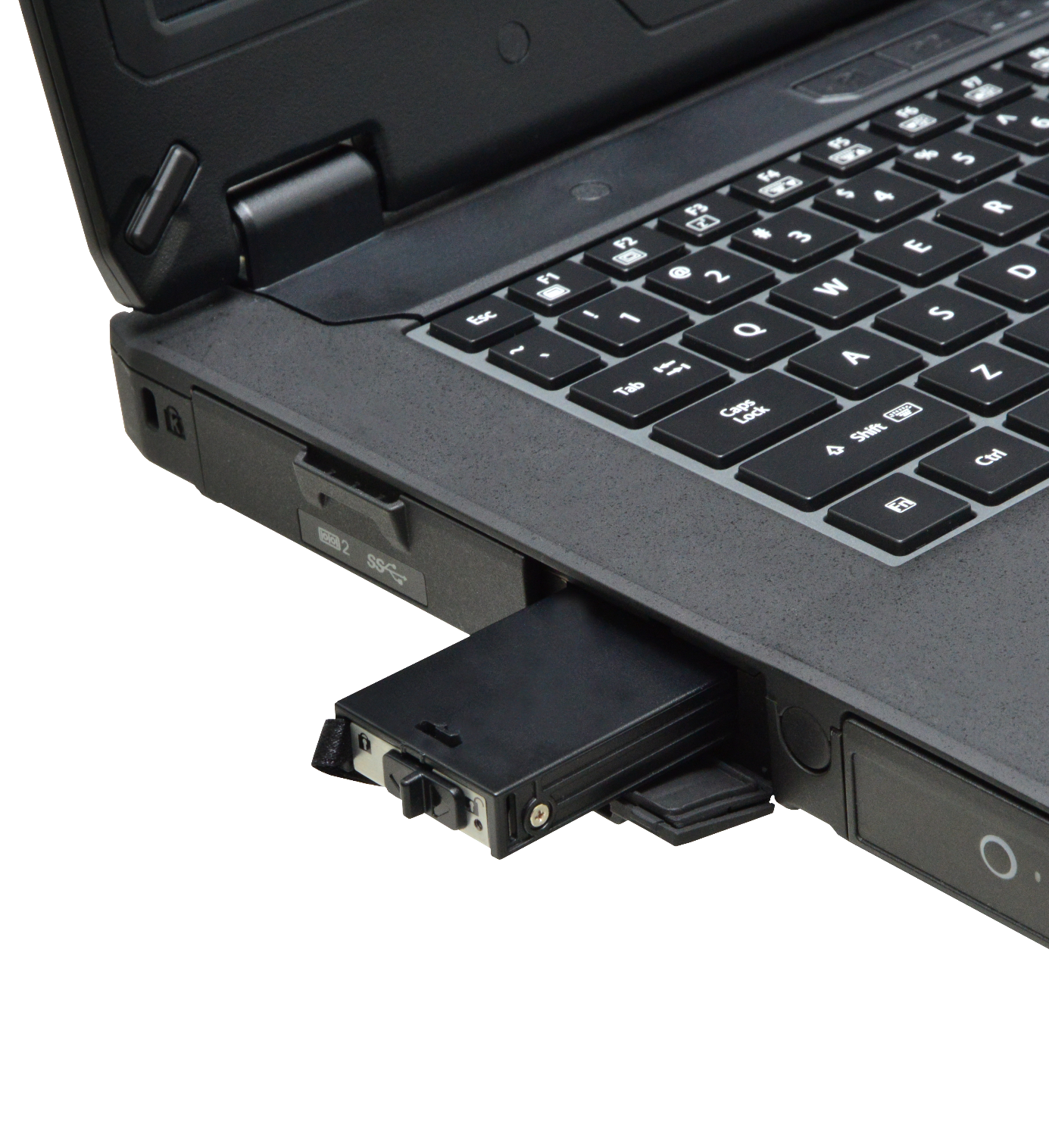
POWERFUL STORAGESECURITY
REMOVABLE quick-release DESIGN
Quick-Release NVMe PCIe SSD Storage
The S14I newly upgraded military-grade protection casing with one unique easy-removable NVMe PCIe SSD storage.
An optional 2nd NVMe PCIe SSD can be installed, providing up to 2TB of each storage.
With two SSDs, the S14I is capable to run RAID 0 and RAID 1

Slide 19
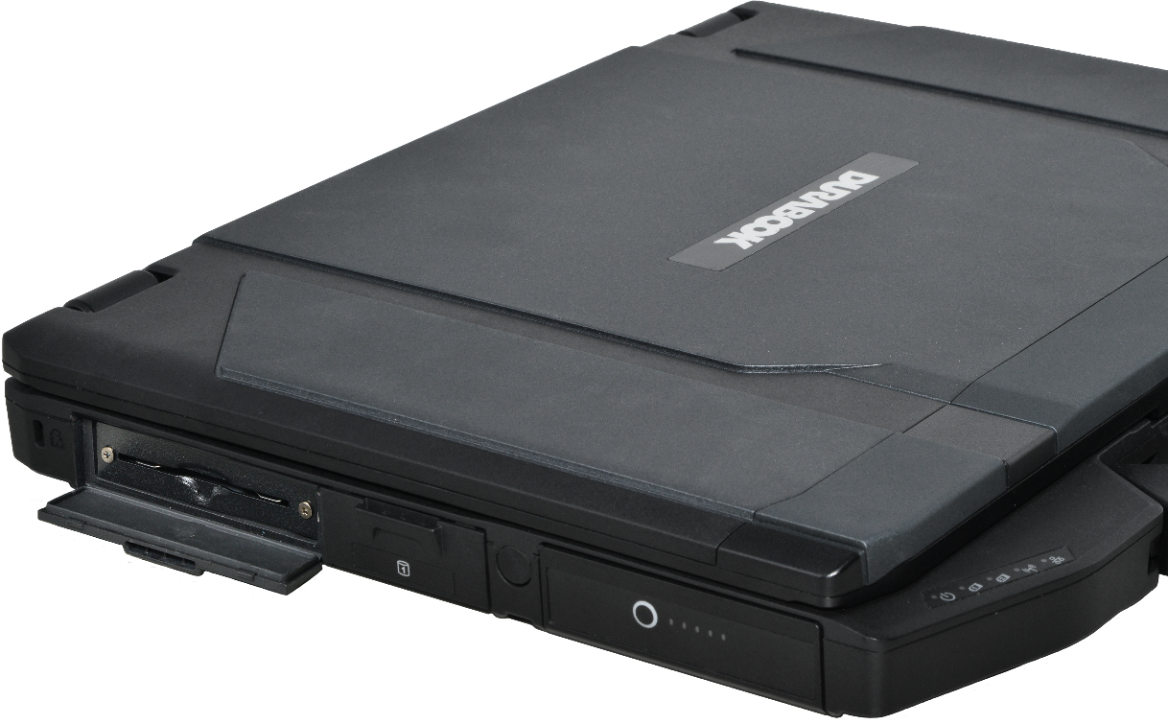
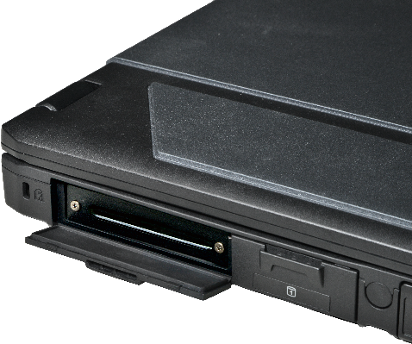
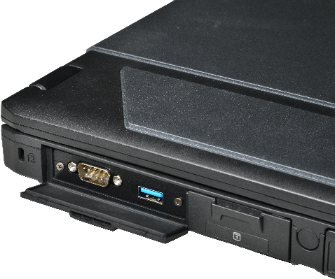
EXTREME VERSATILITY
CONFIGURE TO SUITS YOUR NEEDS
Configuration options for user selection to achieve difference application fulfillments:
Smart card reader
ExpressCard 54
2nd RS-232 + 2nd USB 3.2 Gen1 (Type A)
Barcode Scanner*
Smart Card Reader + 2nd RS-232 +
2nd USB 3.2 Gen1 (Type A)*
Smart card reader
ExpressCard 54 Slot
2nd RS-232 + 2nd USB 3.2
* Project based

Slide 20

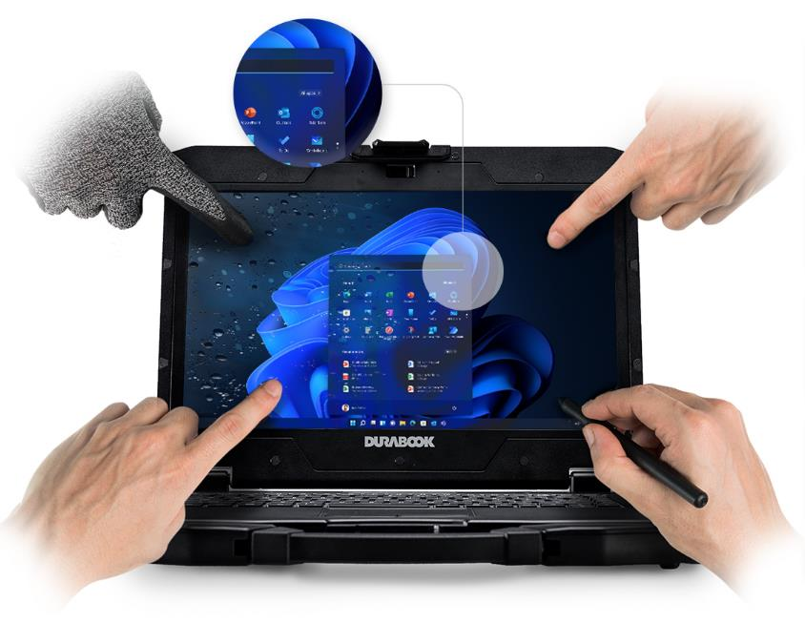

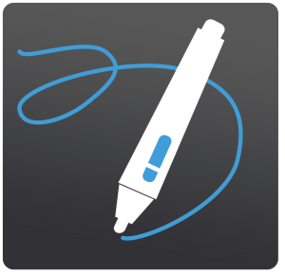


VIEW EVERY DETAIL
The New Generation of DynaVue® Technology
Default with 14” FHD (1920x1080) display
Optional with 1200 nits DynaVue® sunlight readable display
The new DynaVue® light-filtering technology provides a high contrast ratio (CR) to eliminate reflection and deliver the best clarity.
14” FHD
(1920x1080)
4 touch modes: glove, stylus, water and finger mode.

Slide 21
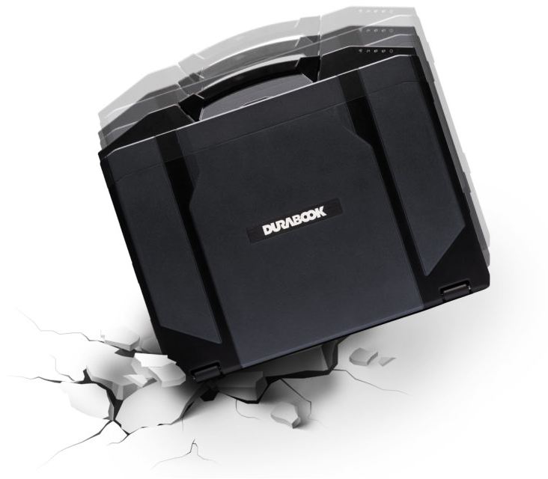


RUGGED DESIGNS 1/2
The S14I expands the definition of semi-rugged computing to include a category first 4’ drop rating and a 33% improvement over the typical semi-rugged computers.
Plus, the S14I is also the first in its class to offer an ingress protection rating of 53 (IP53).
Brand | Drop Withstand | IP Rating
Durabook S14I | 4 feet (122cm) | IP 53
Market Solution G | 3 feet (91cm) | IP 53
Market Solution P | 3 feet (91cm) | IP 53
Market Solution D | 3 feet (91cm) | IP 53

Slide 22



RUGGED DESIGNS 2/2
WIDE TEMPERATURE TOLERANCE
From high ambient temperature to low, and underground construction to high latitude areas, it is not a problem for S14I to operate and adapt under extreme temperature.
Operation: -29°C ~ 63°C /
-20°F ~ 145°F
Storage: -51°C ~ 71°C /
-60°F ~ 160°F

Slide 23


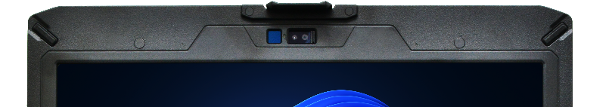
IMPROVED SECURITY WITH WINDOWS HELLO
UTILIZE the Power of biometrics-based TECHNOLOGY
S14I supports Windows Hello face authentication. The new S14I is equipped with a near infrared (IR) camera with facial recognition capability to authenticate and unlock Windows devices. Near infrared camera provides consistent image sensing capability in various ambient light environments, enabling users to login to Windows securely.
Windows Hello
Face Authentication

Slide 24
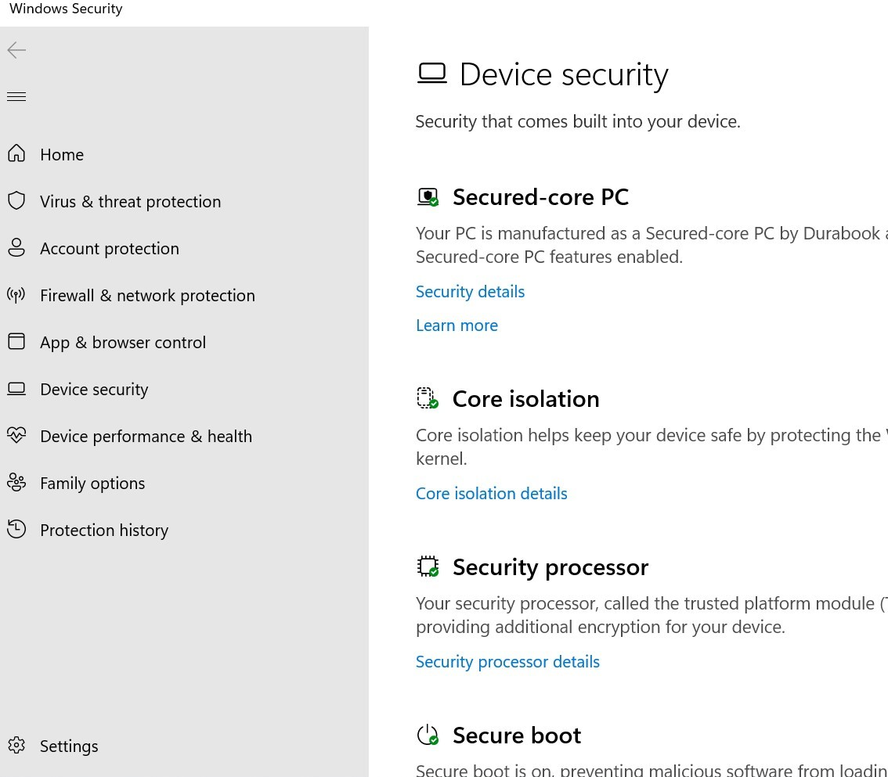
ELEVATE PROTECTION WITH SECURED-CORE PC
SupportING WINDOWS HELLO
*Secured-core PC is project base
Multifactor Authentication (MFA)
    Capacitive Fingerprint Reader
    Camera for Windows Hello facial recognition
    Smart Card reader
    LF/HF-RFID reader
Sniff out any tampering bootups
    TPM2.0 prevents tampering or malicious attacks.

Slide 25
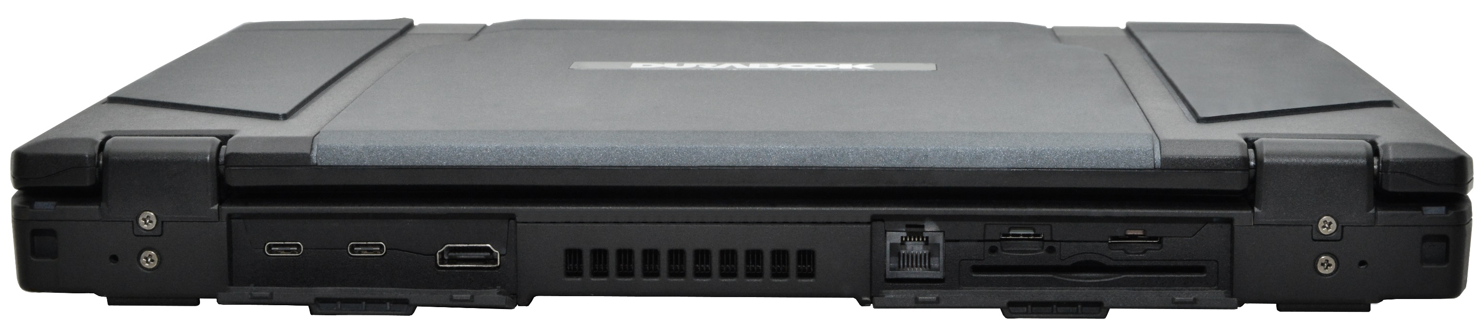
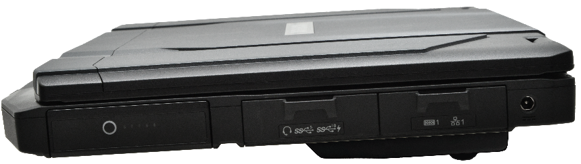

2MP CAMERA WITH PRIVACY SHUTTER
OPTIONAL 5MP IR CAMERA FOR WINDOWS HELLO
S14I ANATOMY
FRONT
BACK
14.0” 1200 NITs SUNLIGHT READABLE DISPLAY
2x THUNDERBOLT 4
RJ-45
2x PROGRAMMABLE KEYS
NANO SIM CARD
MICRO SD CARD
HDMI 2.1
OPTIONAL CAC/SMART CARD READER
OPTIONAL RFID/NFC READER
OPTIONAL FINGERPRINT
S14I with NVIDIA® RTX A500

Slide 26
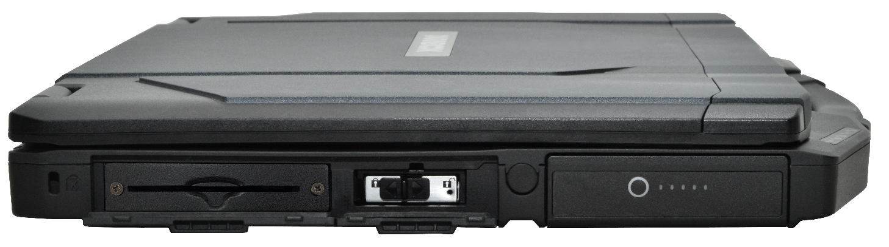
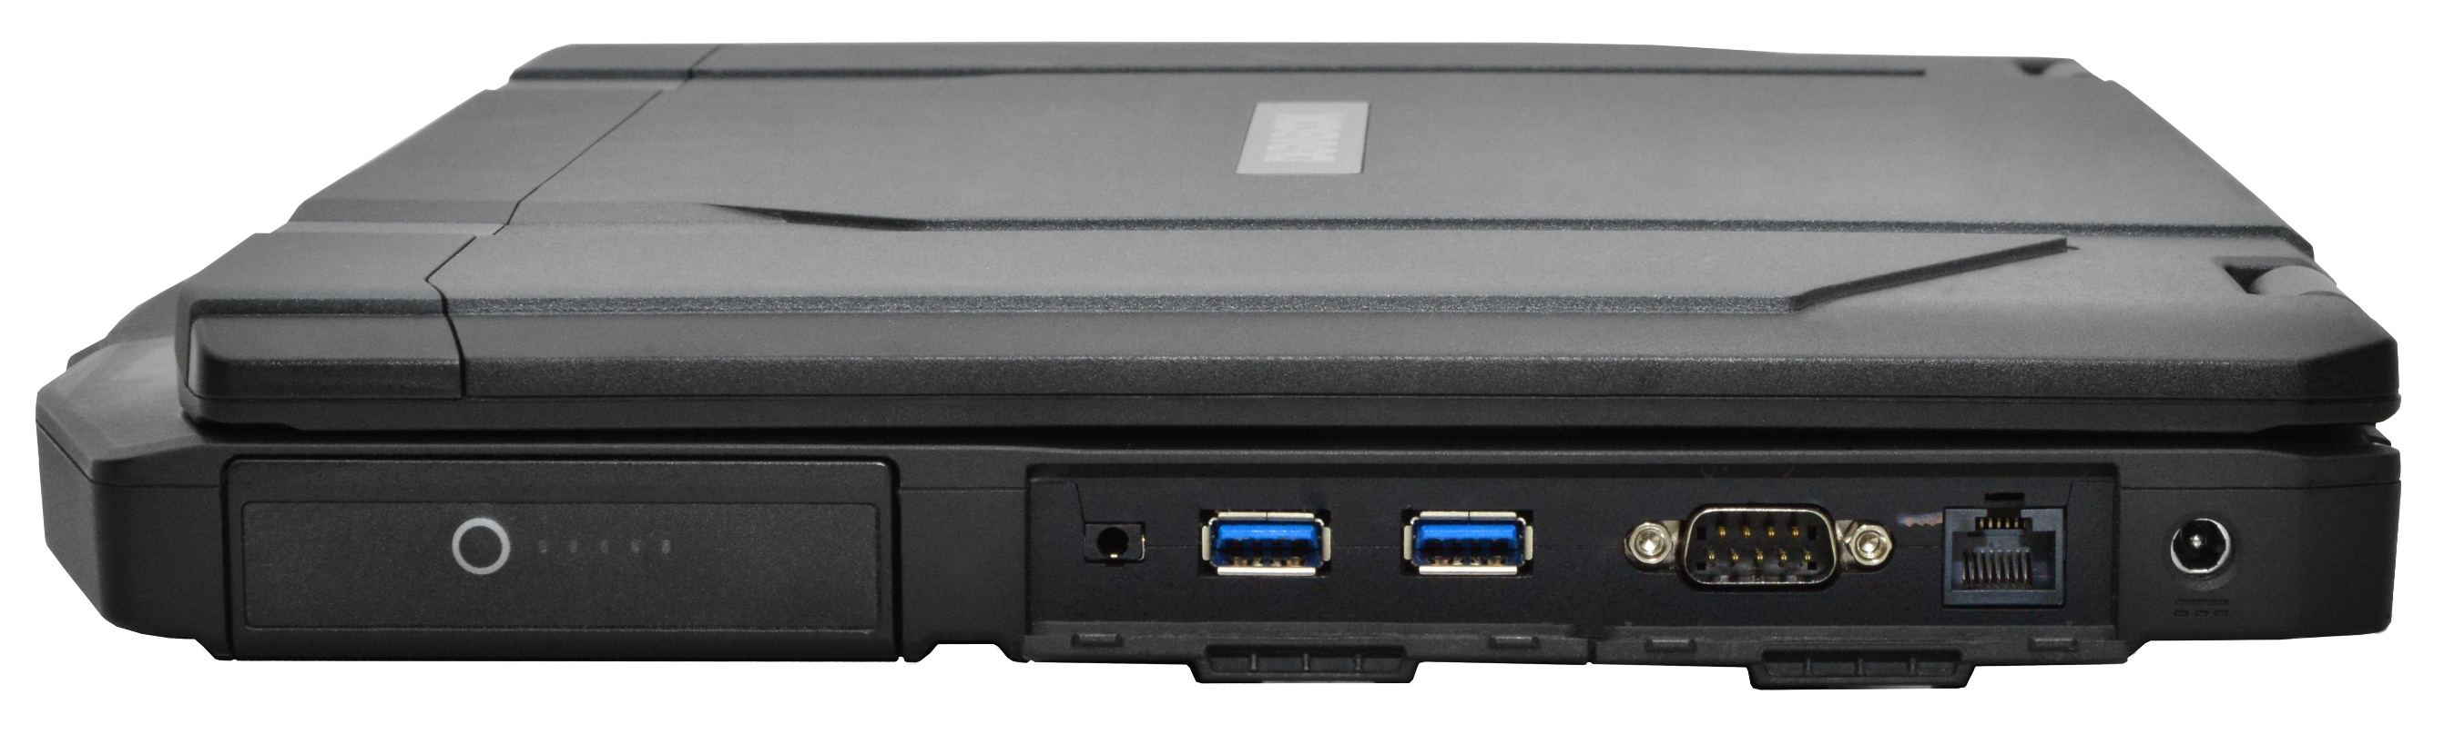
S14I ANATOMY
LEFT
RIGHT
KENSINGTON
LOCK
SWAPPABLE MAIN BATTERY
SWAPPABLE 2ND BATTERY
RS-232
RJ-45
DC-IN
COMPARTMENT FOR STYLUS
AUDIO IN/OUT
1x USB 3.2 Gen 2 (Type A)
1x USB 3.2 Gen 1 (Type A)
OPTIONAL SMART CARD READER
OPTIONAL BARCODE READER
OPTIONAL EXPRESSCARD 54
OPTIONAL 2ND RS-232 &
2ND USB 3.2 Gen 1
QUICK-RELEASE NVME PCIE SSD

Slide 27
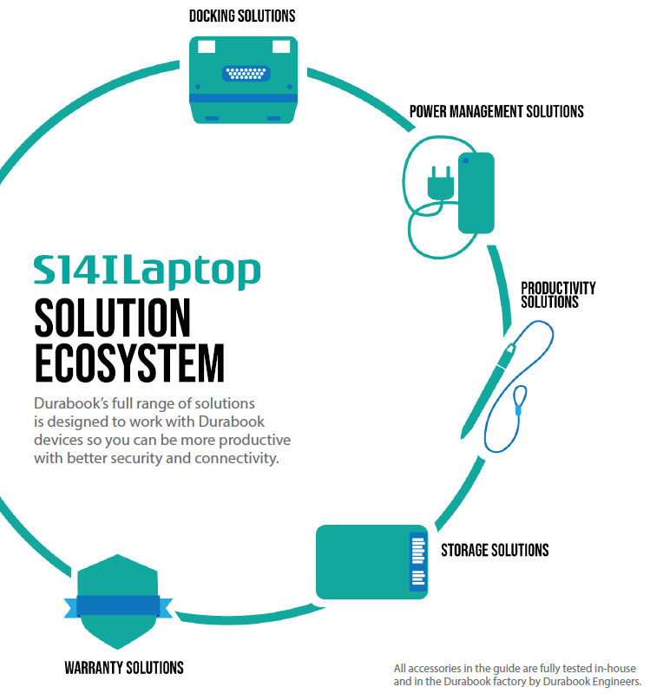
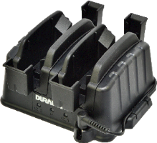
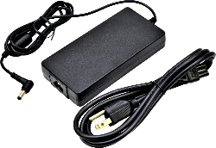
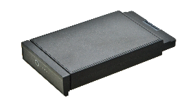









COMPLETE SOLUTION ECOSYSTEM
Whether you're at the desk, in your vehicle, or on site, rugged accessories help you do your job, efficiently and effectively.
Battery Charger & Adapters
Spare Battery & SSD Storage
Office & Vehicle Docks
Shoulder Strap & Stylus
USB Docking Stations

Slide 28





ACCESSORIES
2x USB3.0
2x USB2.0
1x RJ-45
1x DP
1x HDMI
1x VGA
1x RS-232
1x Headphone
1x Mic
1x DC-in
2 Bay Battery Charging Station
Office Dock
8 Bay Battery Charging Station
Vehicle Dock
90W AC Adapter

Slide 29
 | DURABOOK S14I NEW | DURABOOK S14I
Drop | MIL-STD-810H, 4' drop | MIL-STD-810H, 4' drop
IP rating | IP 53 | IP 53
Display | 14” FHD (1920 x1080) with 1,200 nits Optional touch screen display | 14” FHD (1920 x1080) with 1,000 nits Optional touch screen display
CPU | Intel® Core™ Ultra 5 125U (up to 4.3 GHz) / Ultra 5 135U (up to 4.4 GHz) / Ultra 7 155U (up to 4.8 GHz) / Ultra 7 165U (up to 4.9 GHz) | 11th Gen Intel® Core™ i3-1115G4 (3GHz - 4.1GHz) / i5-1135G7 (2.4GHz - 4.2GHz) / i5-1145G7 (2.6GHz -4.4GHz) /i7-1165G7 (2.8GHz -4.7GHz) /i7-1185G7 (3GHz -4.8GHzv)
Graphic | Intel Iris Xe Graphics - Optional NVIDIA RTX A500 | i7/i5: Intel Iris Xe Graphics / i3: Intel® UHD Graphics - Optional NVIDIA GEFORCE GTX 1050
Storage | 256GB/512GB/1TB/2TB NVMe PCIe SSD (quick-release design) - Optional 2nd NVME PCIe SSD - Optional OPAL 2.0 SSD | 256/512GB/1TB NVME PCIe SSD - Optional 2nd/3rd storage (SATA SSD) - Optional OPAL 2.0 SSD
RAM | 16GB up to 64GB DDR5 | 8GB up to 64GB DDR4
I/O Interface | Thunderbolt 4 (type C) x 2, USB 3.2 Gen2 (type A) x 1, USB 3.2 Gen1 (type A) x 1 or 2, Audio in/out (combo jack) x 1, RJ-45 x 2, microSD card (microSDXC) x 1, HDMI 2.1 port (type A) x 1, DC-In jack x 1 Serial port (RS232/RS422/RS485) x 1 or 2, Dual SIM (Nano SIM & eSIM), Optional smart card reader x 1, Optional ExpressCard 54 x 1, Optional docking connector (41-pin Pogo) x 1, Optional RF antenna pass-through | USB 3.2 Gen2 (type A) x 2, USB 3.2 Gen2 (type C) x 1 (support DP), USB 2.0 (type A) x 1 Audio in/out (combo jack) x 1, SD card (SDXC) x 1, RJ-45 x 1 or 2, HDMI port (type A) x 1, VGA port (D-sub,15-pin) x 1, Serial port (RS232/RS422/RS485) x 1 or 2, SIM card x 1, DC-In jack x 1 Optional smart card reader x 1, Optional ExpressCard 54 x 1, Optional docking connector (41-pin Pogo) x 1 Optional RF antenna pass-through
Camera | - 2.0 MP with Shutter Design - Optional 5.0 MP Windows Hello camera | - 2.0 MP with Shutter Design - Optional 5.0 MP Windows Hello camera
Media Bay | Optional smart card reader or ExpressCard 54 or 2nd RS-232 + USB 3.2 Gen1 | Optional ODD or 2nd battery or 3rd SSD or ExpressCard 54 or 2nd RJ-45 + 2nd RS-232
Expansion box | Optional discrete VGA | Optional discrete VGA
Wireless | - Intel Wi-Fi 7 BE200 - Bluetooth v5.4 - Optional 4G LTE, 5G | - Intel Wi-Fi 6 AX201 - Bluetooth v5.2 - Optional 4G LTE
Battery | 16 hrs (up to 32 hrs) - Optional dual hot-swappable battery technology | 10 hrs (up to 20 hrs)

Slide 30
 | DURABOOK S14I | Marketing Solution G (S410) | Marketing Solution P (CF55) | Marketing Solution D (5424) | Marketing Solution D (5430)
Drop | MIL-STD-810H, 4' drop | MIL-STD-810H, 3' drop | MIL-STD-810H, 3' drop | MIL-STD-810G, 3’ drop | MIL-STD-810H, 3’ drop
IP rating | IP 53 | IP 53 | IP 53 | IP 53 | IP 53
Display | 14.0” FHD (1920 x1080) - Optional 1200 nits DynaVue® sunlight readable display without touch screen - Optional 1200 nits DynaVue® sunlight readable display with capacitive multi-touch screen | 14“ HD (1366 x 768) with 1000 nits LumiBond® display with sunlight readable technology Optional 14” HD with 1000 nits LumiBond® display with multi-touch screen Optional 14” FHD (1920 x1080) with 1000 nits LumiBond® display with multi-touch screen | 14“ HD (1366 x 768) 14“ FHD (1920 x 1080) with 1000 nits capacitive touch | 14“ FHD (1920 x 1080) Optional outdoor readable display with optional glove capable capacitive touchscreen | 14.0" FHD(1920 x 1080) with 400 nits Optional 1100 nits outdoor viewable screen
CPU | Intel® Core™ Ultra Series - Intel® Core™ Ultra 5 125U (up to 4.3 GHz) - Intel® Core™ Ultra 5 135U (up to 4.4 GHz) - Intel® Core™ Ultra 7 155U (up to 4.8 GHz) - Intel® Core™ Ultra 7 165U (up to 4.9 GHz) | 11th Generation Intel® Core™ - Intel® Core™ i3-1115G4 (up to 4.1GHz) - Intel® Core™ i5-1135G7 (up to 4.2GHz) - Intel® Core™ i5-1145G7 vPro™ (up to 4.4GHz) - Intel® Core™ i7-1165G7 (up to 4.7GHz) - Intel® Core™ i7-1185G7 vPro™ (up to 4.8GHz) | 11th Generation Intel® Core™ - Intel® Core™ i5-1145G7 vPro™ (up to 4.4GHz) - Intel® Core™ i7-1185G7 vPro™ (up to 4.8GHz) | 8th Generation Intel® Core™ - Intel® Core™ i5-8350U (1.7GHz) - Intel® Core™ i7-8650U (1.9GHz) | 11th Generation Intel® Core™ - Intel® Core™ i5-1135G7 (2.4GHz -3.8GHz) - Intel® Core™ i5-1145G7 vPro™ (2.6GHz -4.0GHz) - Intel® Core™ i7-1185G7 vPro™ (3.0GHz -4.3GHz)
Graphics | Intel® Iris® Xe Graphics Optional NVIDIA® RTX A500 | i7/i5: Intel® Iris® Xe Graphics i3: Intel® UHD Graphics Optional NVIDIA® GeForce® GTX 1650 | Intel® Iris® Xe Graphics Intel® UHD Graphics | Intel® UHD Graphics 620 AMD 540/RX540 | Intel® Iris® Xe Graphics Optional NVIDIA T500
Storage | 256GB NVME PCIe SSD (Quick release design) Optional 512GB/ 1TB /2TB NVMe PCIe SSD Optional 2nd storage NVMe PCIe SSD Optional OPAL 2.0 SSD | 256GB PCIe NVME SSD Optional 512GB/1TB/2TB PCIe NVME SSD Optional 2nd storage (SATA SSD) | 512GB, 1TB or 2TB quick-release OPAL NVMe SSD Optional 2nd storage (SATA SSD) | 128/256GB NVME PCIe SSD Optional 512GB/1TB PCIe SSD Optional Encrypting SSD Optional 2nd/3rd storage (SATA SSD) | 128/256GB NVME PCIe SSD Optional 512GB/1TB PCIe SSD Optional Encrypting SSD
RAM | 16GB up to 64GB DDR5 | 8GB up to 64GB DDR4 | 16GB up to 64GB DDR4 | 8GB up to 32GB DDR4 | 8GB up to 64GB DDR4
I/O Interface | Thunderbolt 4 (type C) x 2 USB 3.2 Gen2 (type A) x 1 USB 3.2 Gen1 (type A) x 1 or 2 Audio in/out (combo jack) x 1 microSD card (microSDXC) x 1 10/100/1000 Ethernet (RJ45) x 2 HDMI 2.1 port (type A) x 1 Serial port (RS232/RS422/RS485) x 1 or 2 Dual SIM (Nano SIM & eSIM). DC-In jack x 1 Optional smart card reader x 1 Optional ExpressCard 54 x 1 Optional docking connector (41-pin Pogo) x 1 Optional RF antenna pass-through for GPS, WWAN, and WLAN | USB 3.2 Gen2 (type A) x2, USB 2.0 x1, HDMI x1, RJ45 x1, d ocking con x1, Audio in/out Combo x1, DC in jack x1, Optional Thunderbolt 4 Optional SIM card slot Optional RF Passthrough Optional Serial port (D-sub) + VGA + RJ45 Optional Serial port (D-sub) + VGA + PowerShare USB 3.2 Gen 1 (type A) Optional Serial port (D-sub) + DP + RJ45 Optional Serial port (D-sub) + DP + PowerShare USB 3.2 Gen 1 (type A) | Thunderbolt 4, USB A x2, Micro SDXC, HDMI, RJ45, Audio in/out, dual SIM Optional USB A Optional Fischer USB Optional VGA Optional 2nd RJ45 Optional Serial D-sub 9-pin | USB 3.1 Gen1 (type A) x3, USB 3.1 Gen2 (type C) x1, (support PD), Docking connector x1, HDMI x1, RJ-45 x1, RS-232 x1, Smart card x1, Audio Jack, SD and SIM card Optional 2nd RJ-45, 2nd Serial, VGA, Display port or Fischer USB Optional PCMCIA or Express Card54 | Thunderbolt 4 x1, USB 3.2 Gen1 x1, USB 3.2 Gen1 (with power share) x1, HDMI x1, RJ-45 x1, RS-232 x1, Combo headphone & microphone, Mircro SD card, Nano SIM card Optional: Thunderbolt 4 Optional: RJ-45/USB Type A/ Fischer USB 3.0 9 pin Optional: Smart card reader Optional: Contactless card reader
Media Bay | Optional smart card reader or ExpressCard 54 or 2nd serial port (RS232) & USB 3.2 Gen1 (type A) | Optional ODD or 2nd Batt or 2nd SSD or PCMCIA-II or Express Card34/54 or barcode scanner | Optional DVD drive
Wireless | Intel® Wi-Fi 7 BE200, 802.11ax Bluetooth v5.4 Optional 4G LTE & 5G | Intel® Wi-Fi 6 AX201, 802.11ax Bluetooth v5.2 Optional4G LTE | Intel® Wi-Fi 6 AX201 Bluetooth v5.1 Optional 4G LTE | Intel Dual Band Wireless AC 8265 Bluetooth v4.2 | Intel® Wi-Fi 6 AX201, 802.11ax Optional Bluetooth Optional 4G LTE
Battery | 16hrs (up to 32hrs) | 12hrs | up to 19hrs | 14hrs | 25hrs

